Slide 1
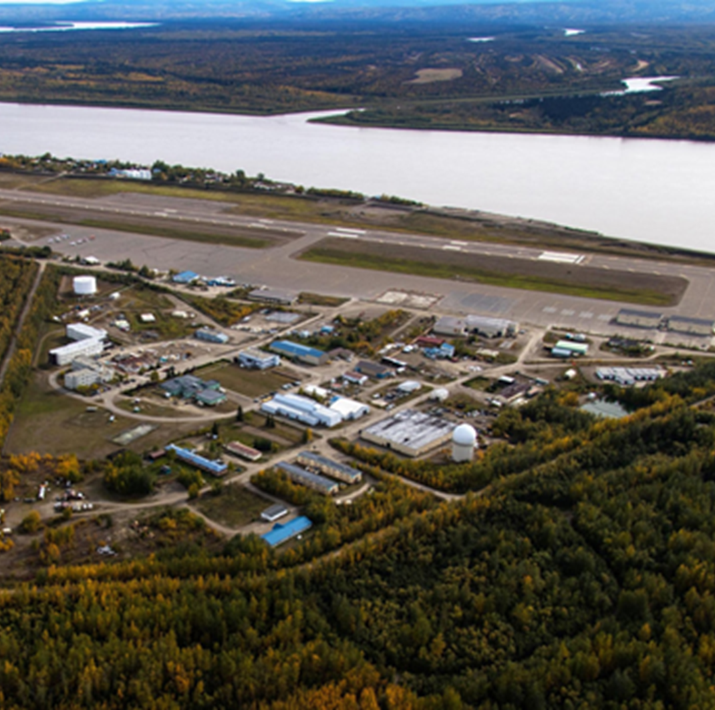
Sustainable Energy for Galena Alaska
Our MISSION:
Through strengthening of community partnerships, Team SEGA will increase the utilization of renewable energy in Galena, Alaska to address our extremely high energy costs ($.72/kWh), improve community sustainability, spur economic development, and create local jobs.
Our PARTNERS:
City of Galena
Louden Tribal Council
Galena City School District
Gana-A’Yoo, Incorporated
DeerStone Consulting, LLC
Tanana Chiefs Conference
What is SUCCESS?
When Team SEGA streamlines energy development, the result will be a 2 -3 year project development timeline with opportunities for replication and job creation.

