Slide 1

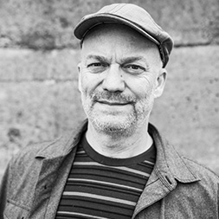
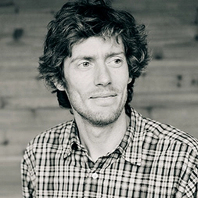
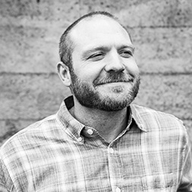
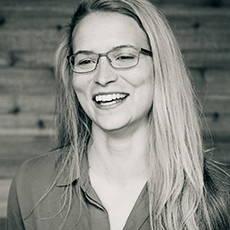
ALAN HORTON
Managing Director
DAVID MCKAY
IMP Project Staff
KEITH KUENY
Special Projects Manager
MATTIE BOSSLER
Water Resources Engineer
Farmers Conservation Alliance
In partnership with rural communities, we are tirelessly in pursuit of water management solutions that benefit agriculture and the environment. Through the modernization of irrigation infrastructure across the west, rural communities are ensuring agricultural resiliency, generating green, renewable energy, saving precious water, reducing agricultural operations costs, restoring critical habitat, and protecting endangered species.

