Slide 1
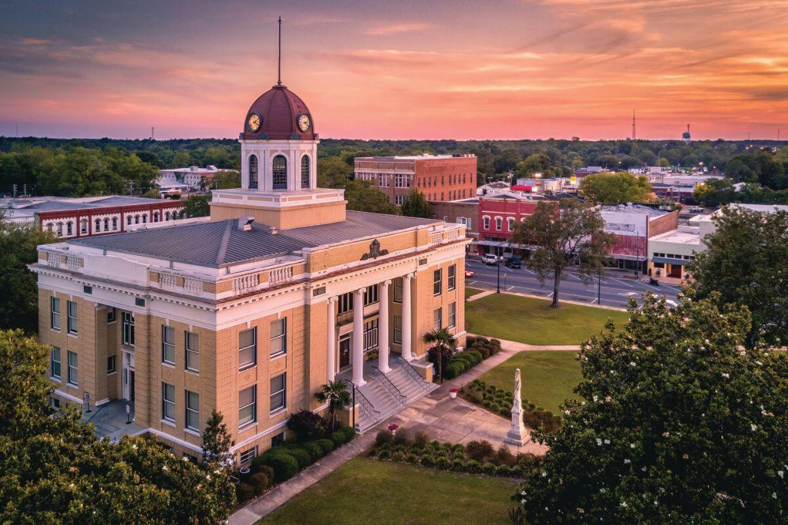


Big Bend Community Development Team
We will develop a renewables implementation plan for Quincy, Florida. Quincy owns an electric utility but negligible generation assets. Existing power purchase agreements (PPA) with other utilities obstruct Quincy’s ownership of new generation assets. Moreover, existing PPAs often sell power with expensive fuel demand charges. Quincy can avoid these demand charges via local solar generation.

