Slide 1
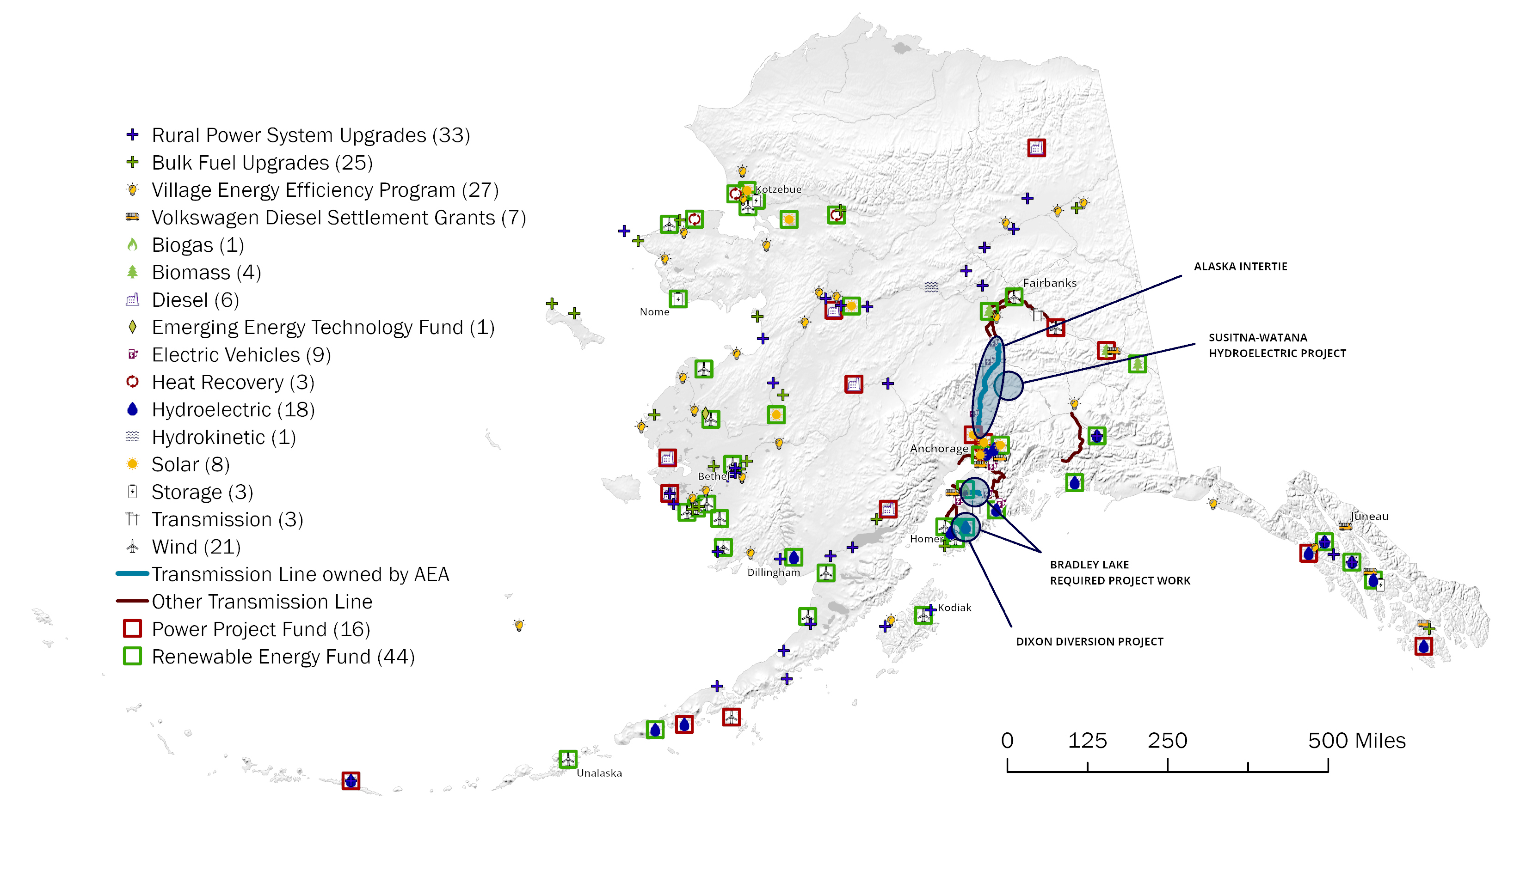

Rural Alaska Municipal Energy Accelerator
This project will leverage AML’s unique relationships with its municipal members and established State, federal, and nonprofit partners to accelerate financing the needs of local microgrids. AML staff will work directly with municipal governments to strengthen their ability to accelerate new and more efficient power systems that anticipate future needs and resilience, and that can leverage public and private capital investment.
AEA Active Projects and Services
Community
Benefits
Resource identification for asset management
Project investment
Energy
Projects
Analysis and partnerships that support renewables integration opportunities
Microgrid efficiency
Municipal
Governance
Technical assistance that strengthens financial management
  Oversight and administration

