Slide 1

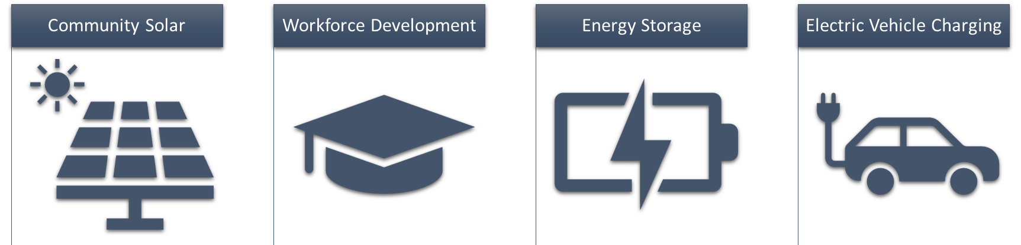
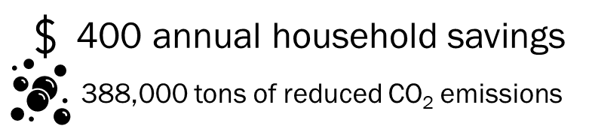

SUN Rural Solar Partnership
OUR MODEL
WHO WE ARE
Community
Solar Farm
Training Building
Solar United National is a Charleston, South Carolina based solar developer. Our team has over 155 projects in operation (over 33 MW installed).
In our home state of South Carolina, energy costs can exceed 20% of household income. The national average energy burden is three times* higher for low-income households. Low-income households cannot access the benefits of solar because:
59% of low-income households are renters
High up-front costs
Qualifying for financing**
Inability to take advantage of tax benefits
Unsuitable location due to roof conditions or shade
Our projects will have two components, a community solar farm, and a training building. Paid trainees learn hands-on by installing the ground mount (farm) and rooftop (building) panels. The training buildings also serve as resilience and disaster recovery centers.
IMPACT (by 2025)
Equivalent to carbon sequestered by 416,555 trees
OUR GOALS FOR 2025
PRIZE GOALS
40% Low- to moderate-income beneficiaries
6 Community Solar Sites completed (6MW)
50% Community owned after 5 years, 100% after 10 years
500 Trainees
Lower cost
Resilience, Grid Upgrades, Capacity
Self-Reliance Community Wealth Building
Clean Energy Knowledge
*www.energy.gov/scep/slsc/low-income-community-energy-solutions
**www.energy.gov/sites/default/files/2021-07/ee-financing-lmi.pdf

