Slide 1

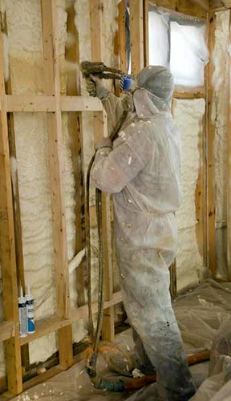

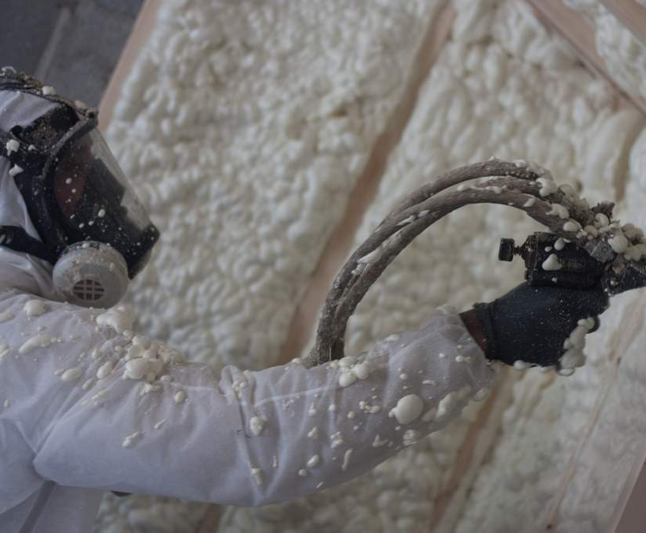
E.T. Foam Home
(Energy Transformation Foam Home Insulation)
Georgette Sims – Georgette Jean Enterprises, LLC
Your Business is OUR Business - Providing solutions to challenging issues since 2018
A unique approach to gain support and partnerships for increasing home energy efficiency in a rural Michigan community.

