Slide 1
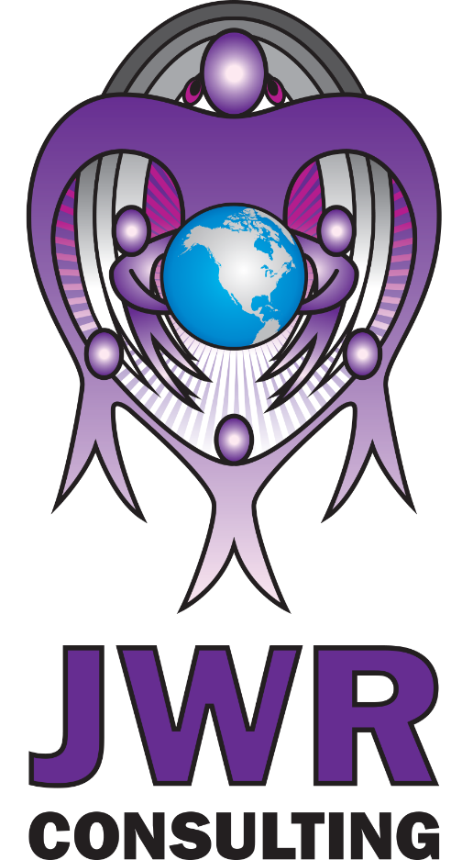


Developing the Ratiwé:ras Energy Resiliency Plan
PROJECT ABSTRACT
Helping the Saint Regis Mohawk Tribal Community to become energy interdependent by exercising its sovereignty, create an energy self-reliant path, acquire electrical distribution assets, improve electric system reliability, boost employment, achieve cost savings, eliminate exposure to rising rates, and create energy-based economic development and partnership opportunities.
A Proposal to Achieve Energy Interdependency

