Slide 1
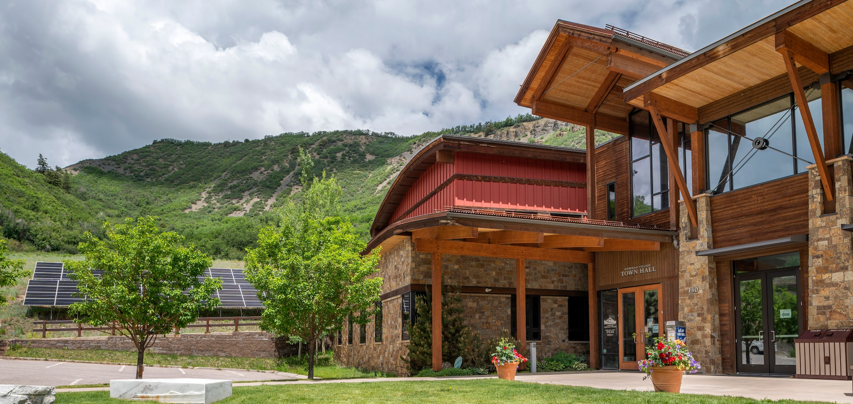
CORE
Community Office for Resource Efficiency
OUR PURPOSE
We believe an independent leader and regional partner is critical to urgently reduce our region’s contribution to climate change through the strategic deployment of innovative and responsive technical assistance and climate action.
OUR MISSION
Leading the Roaring Fork Valley to a carbon-free, net zero energy future.
OUR DRIVE
To serve as a resource hub for the Roaring Fork Valley, a growing rural mountain region in Colorado, by bringing more partners and resources to the table. Together, we will maximize how we modify multifamly buildings to be more energy efficient, and directly address the climate crisis.

