Slide 1

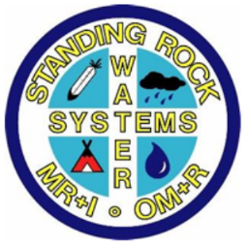
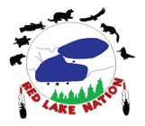






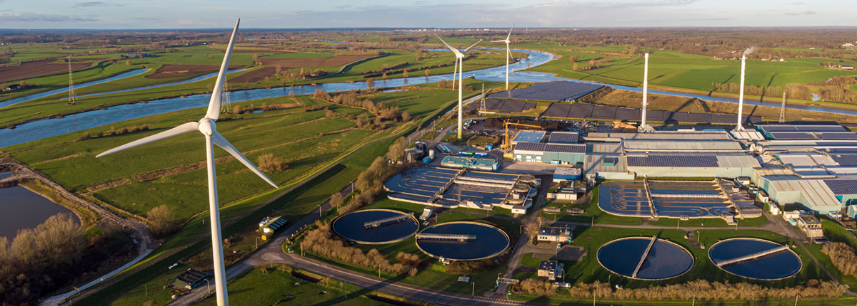

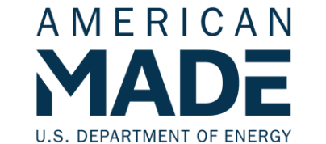
Clean Community Options for Water Systems
Midwest, North-Central, Northwest & Nationwide
Team
Windustry CCOWS
Partnership
Key Project Members
Windustry’s work with diverse rural communities and their water systems will design and develop on-site wind, solar, storage, biodigesters, and EVSE. Justice40 success metrics include:
$ invested in work executed within underserved communities;
# of and $ budgeted
to organizations
with funded roles
representing
underserved
communities; and
# of stakeholder
engagement
events including
DEIA participants
Lisa Daniels, Windustry, Annandale, MN
Randez Bailey, Standing Rock Sioux, Ft. Yates, ND Heather Rhoads, eFormative Options, Lacey, WA
Program Activities
Phase 1: Relationship-building with partners
Phase 2: Interviews to gain lessons learned/best practices; community engagement; benefits assessments; high-level feasibility studies/site development plans; grant applications
Phase 3: Financing development; interconnection studies; construction planning & scheduling; share success stories
Mission and Impact
Windustry’s mission is to promote sustainable
energy solutions and empower communities
to develop and own clean energy assets.
As an independent voice and resource acting in
support of communities, we work – through education, outreach, advocacy – to advance broad community commitment to renewable energy.
Wind, Solar, Storage, Biodigester and EVSE Energy Resilience

