Slide 1
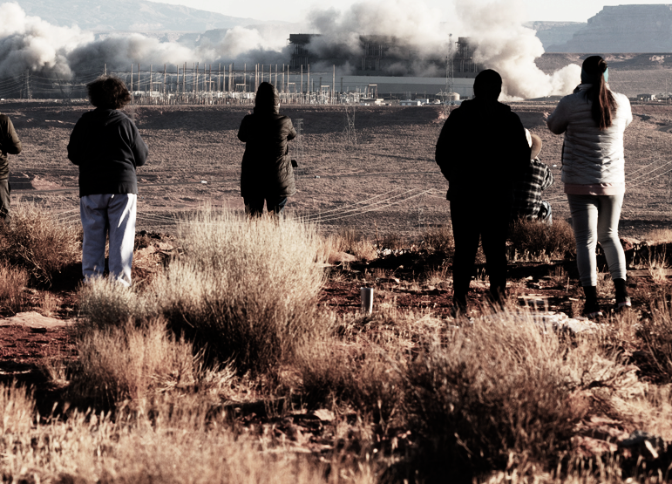

Workshops in Clean Energy
Energy Audit Models
Task Force on Clean Energy
Guidelines for Outreach
Grant Workshops
Business Model
Technical Certification
Mingxi Liu, Assistant Professor, Electrical Engineering, University of Utah
Mostafa Ardakani, Associate Professor, Electrical Engineering, University of Utah
Shundana Yusaf, Associate Professor, Architecture, University of Utah
Renae Hoshnic, Nááts'íilid Initiative
Notes:
Image Credit: A crowd gathers as the smokestacks of the Navajo Generating Station come down in December outside Page, Arizona. Cassidy Araiza/High Country News

