Slide 1

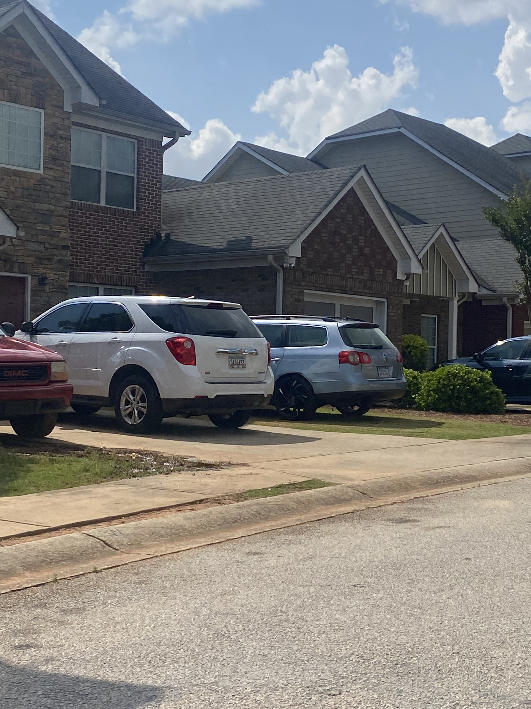
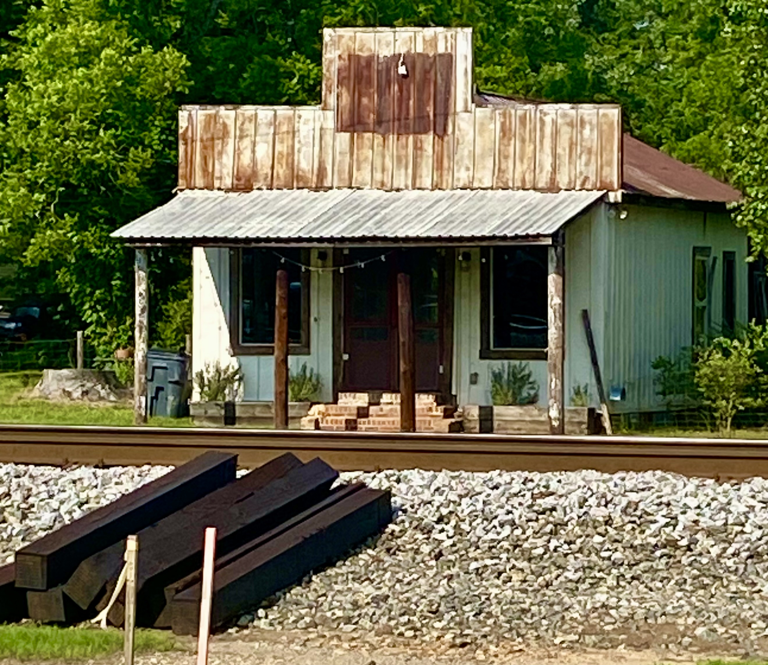
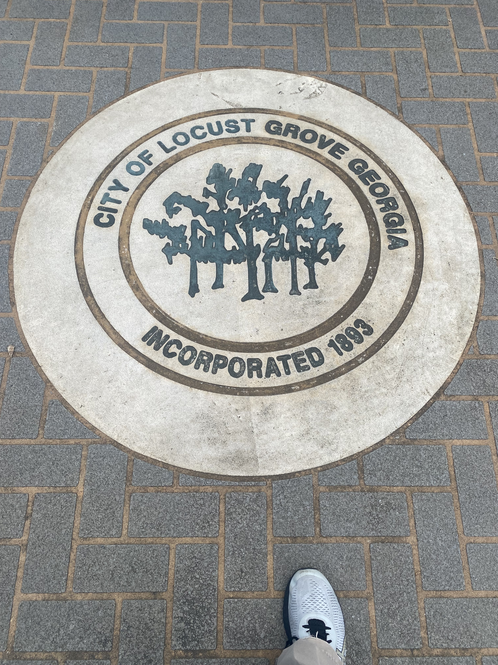
Energizing The rural community of Locust Grove, Georgia
Competitor: Mahogany Property Management, LLC
Attic Insulation Project
* Reduced Energy Usage
* Reduced Carbon Footprint
* Lower Utility Bills
* Use of Current Infrastructure

