Slide 1
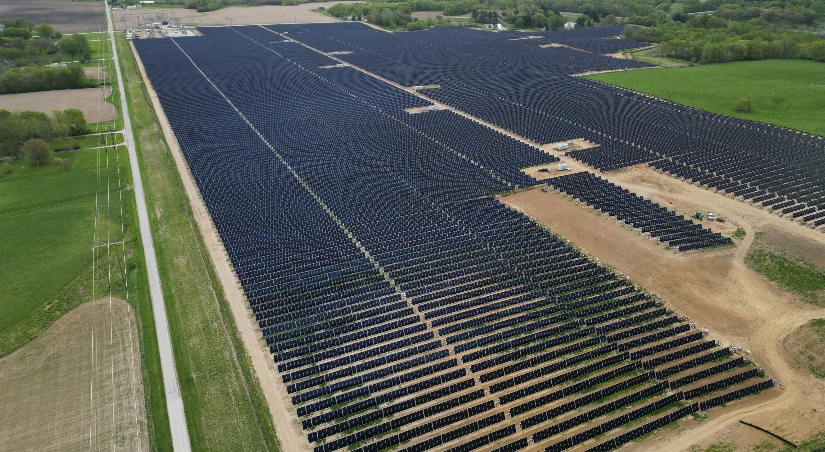
SOLAR FARM PROJECT
Partnership between D-Rich Transport and Youth and Adult Center
Goal: Construct a solar farm to generate clean energy and provide job training opportunities for residents in the southern suburbs of Chicago, Illinois
Reduce reliance on fossil fuels, increase community resilience, and contribute to a more sustainable future
Community engagement and partnership development are key components of the project
Pictured: Solar farm under construction in Jacksonville, IL

