Slide 1
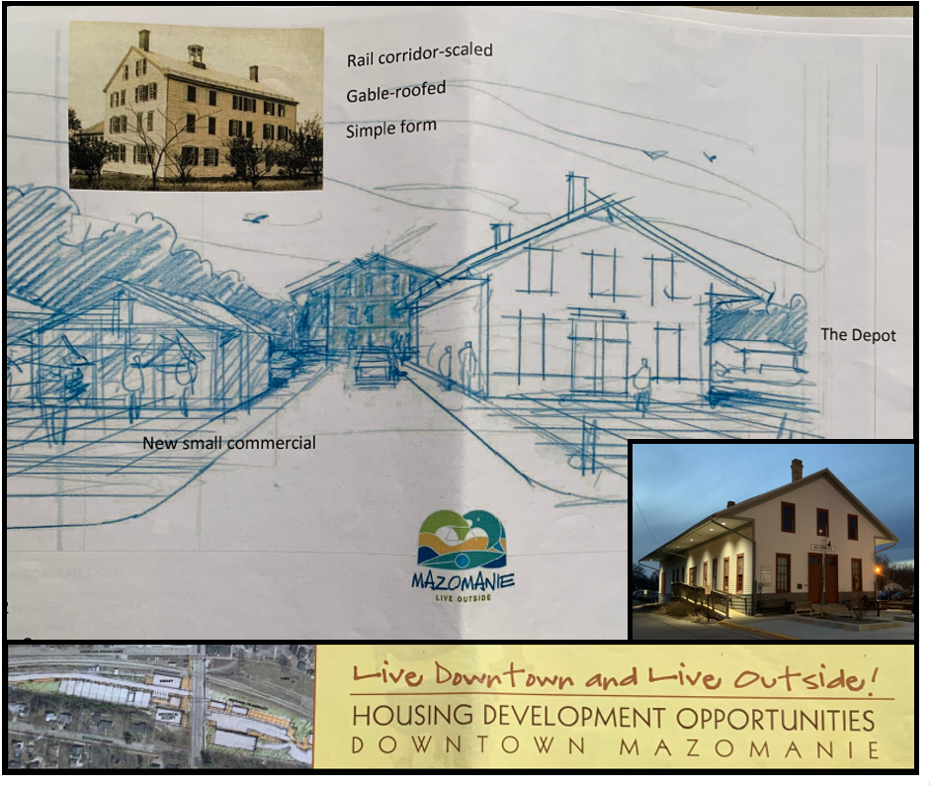
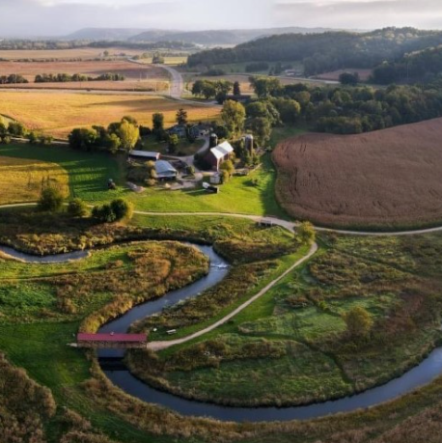
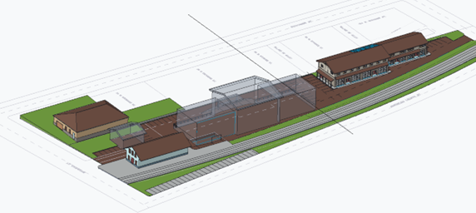
The Iron Horse Residence & Artistry
Energizing Rural Communities Application Slide
Stokes LLC
May 1st, 2023
Measurable benefits to rural energy customers through 7.6 kW of solar accessible from the commercial rooftop array, lower utility bills and reducing environmental pollutants.
Live/Work model leads to more local small businesses, promotes rural economic resilience, helps fund shared solar all while incorporating best practices of solar energy and all-electric technologies.
The Iron Horse Residence and Artistry is committed to building clean energy knowledge, capacity, and self-reliance in rural America.

