Slide 1

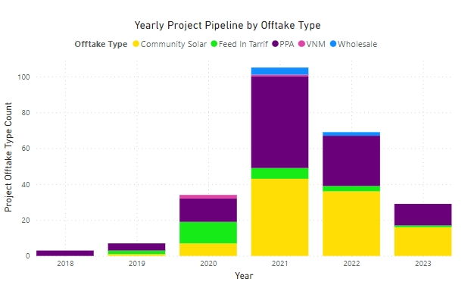

A solar energy company that directs its efforts toward projects that serve municipalities, the environment, and people.
Davis Hill Development’s community solar pipeline of 150MW is enough energy on an annual basis to:
With a large and rapidly growing community solar pipeline across the United States, Davis Hill Development is positioned to be a major contributor to energy savings, equitable energy access, and economic development in the communities it serves for decades to come.
Power 27,456 homes
Charge 17 billion smartphones
Fuel 30,400 vehicles
Avoid 78,000 tons of coal burning
www.davishilldevelopment.com

