Slide 1
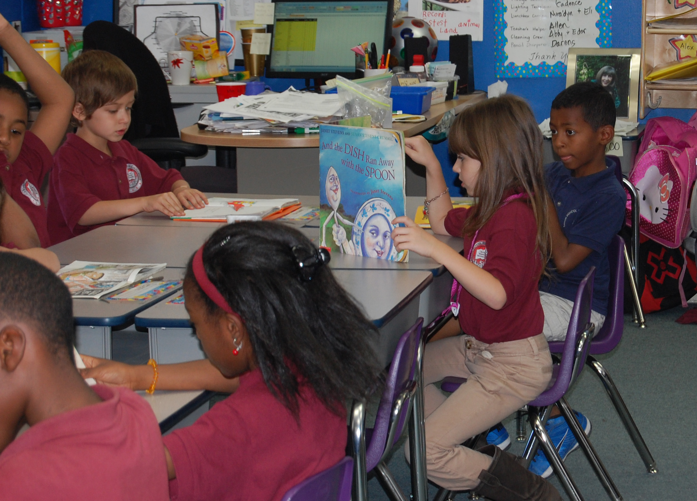
HOW CAN WE HELP?
Our team has tools that can be used to serve our communities today:
Twelve years of experience in Solar Energy Systems and still learning, but our knowledge is to help others.
Our team has been involved in over three hundred (300) Solar Energy Systems. We would like more.
Over four decades of combined marketing experience, ready for action.
We love to participate in and help the community’s goals, especially working with disadvantaged communities. We know that reducing poverty makes our country stronger. So, we want to help.
Some people believe that talking about love is not professional. That is an issue for us because we love our job. We love Solar Energy. We love our Country and our people. We would love to use our resources to help our communities and environment.
In the end, and from the beginning, we all are COMMUNITY.
Is here to help.

