Slide 1
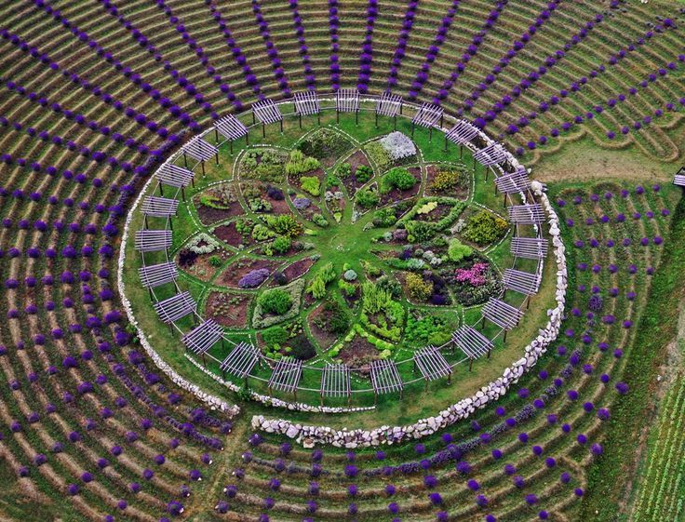
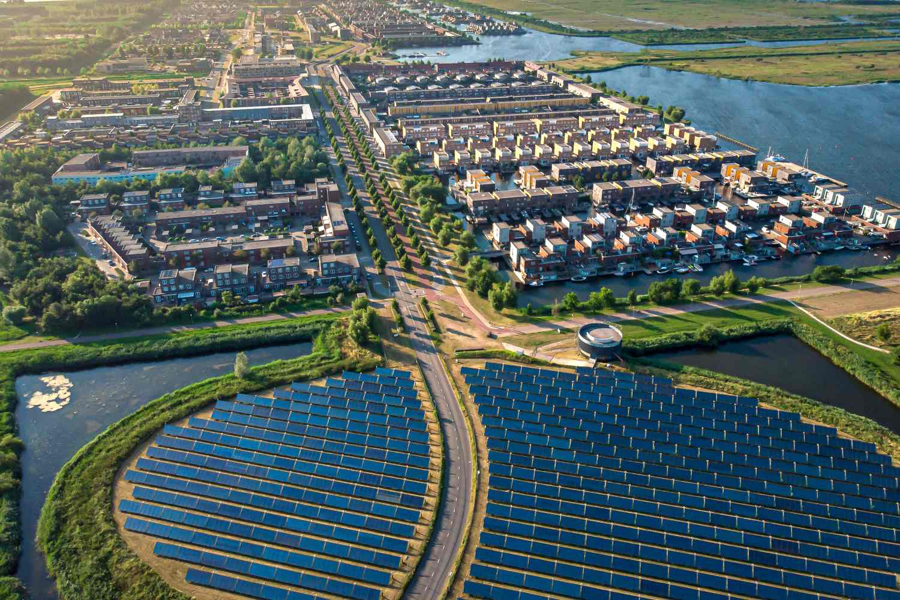
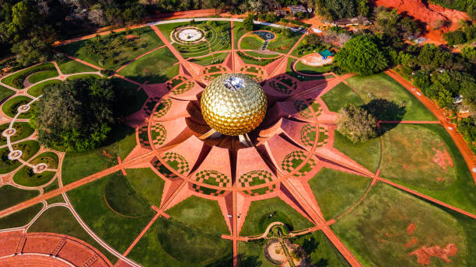

Bhakti-Agora Co-Op
The Devotion Solar Plantation
Communal Projects in Co-Op Pipeline:
+ Vicksburg, MS 500 KW
+Jackson, MS 500 KW
+Rawlins, WY. 5 MW
Partners in Power Development:
*PowerField Energy
*Tiny Home Villages
*MS Center for Police and Sheriffs
*Gateway Rescue Mission
*Gutami Holdings BV
*African Business Institute
Equitable Workforce Development:
-NABCEP Training
-“Soul Capital”
-Encourages community engagement through service and Union

