Slide 1
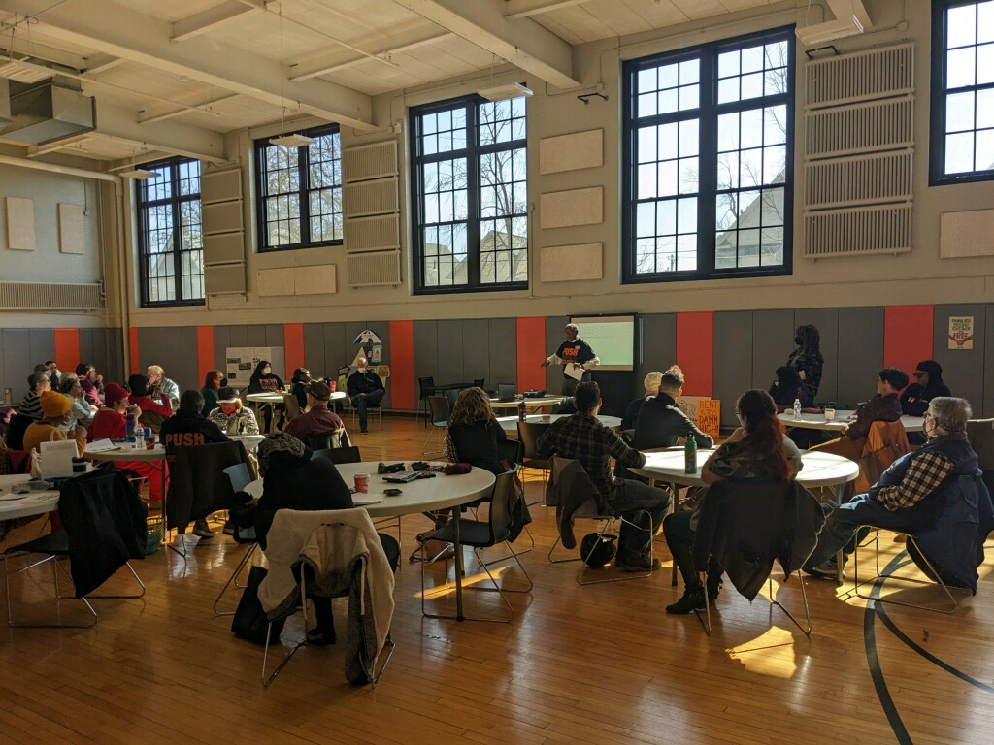
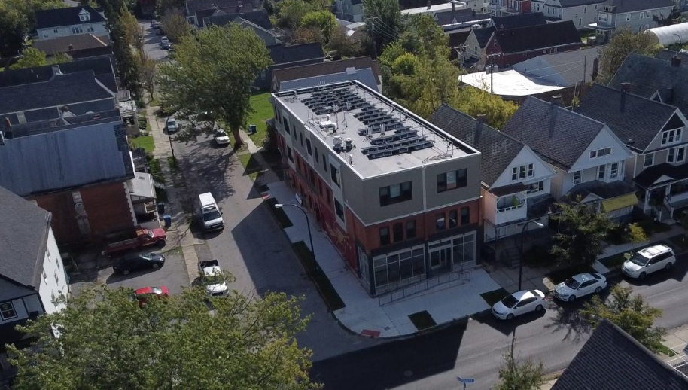


Community Power Buffalo
ABOUT PUSH Buffalo
MEANINGFUL BENEFITS
COMMUNITY ENGAGEMENT
People United for Sustainable Housing (PUSH) Buffalo’s mission is to mobilize residents to create strong neighborhoods with quality, affordable housing; to expand local hiring opportunities; and to advance racial, economic, and environmental justice in Buffalo. PUSH centers the leadership and lived experiences of poor and working-class communities and communities of color in issue-based organizing campaigns, direct service programs, and place-based sustainability projects.
1 MW community solar array
Co-designed with PUSH and community members
Offer benefits beyond the typical 10% for income limited residents
Work with Erie County to engage HEAP recipients as potential subscribers
PUSH conducts outreach on a near daily basis through:
Door-to-door canvassing
Phone banking
Member-led campaign and project planning and strategy meetings
Social media
Community event tabling
1-on-1 relationship building,
Arts, cultural, and youth programming
50/50 ownership with Working Power
The WASH Project
The most recently completed solar project
$540,000 in energy cost savings (15% savings increased depending on available incentives and funding
Equitable Workforce Development in partnership with Erie County
1st floor – Laundromat and community space
2nd & 3rd floors- 9 units of affordable rentals
14.7 kW solar array behind the only residential meter
$203,000 community ownership dividend to support a community benefit fund
Approximately 285 low-income households receive reduced-cost electricity
20,825 metric tons of CO2 equivalent avoided
Notes:
details about the project: size, production, households served, energy savings, community benefit, etc.
recognition of the DOE meaningful community solar benefits that the prize will provide for the project:
LMI Household access
greater household savings
resilience and grid benefits
community ownership
equitable workforce development
information/ demographics about the community
information about the community group and goals for community solar
logos of community group and UI and WP + some proposals have other partners.

