Slide 1
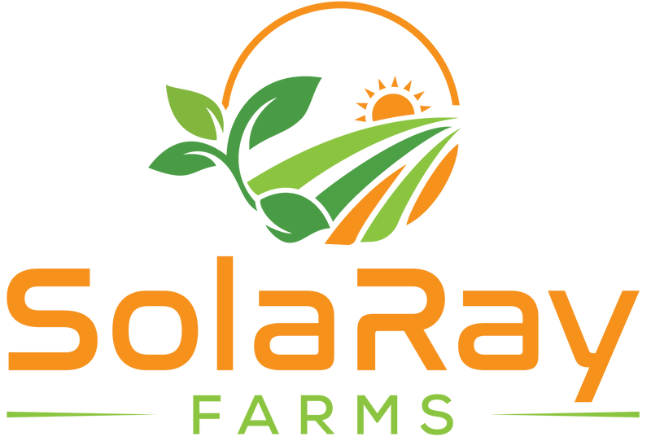
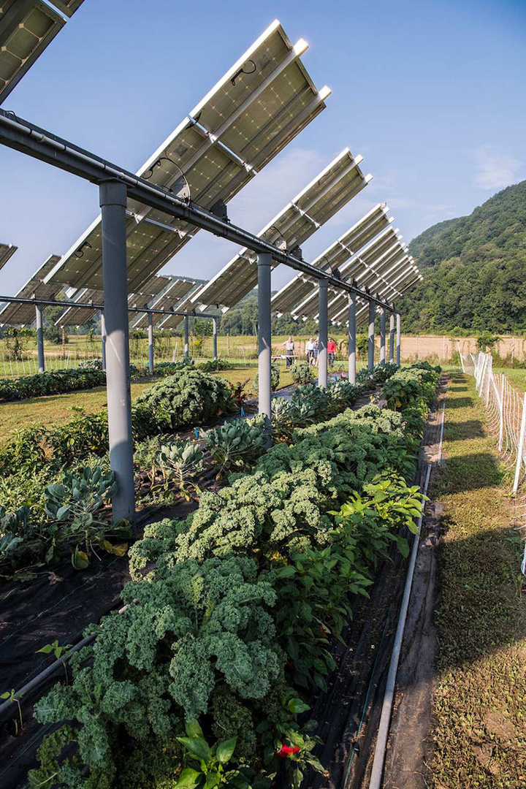

Community Solar & Agrivoltaics
Vision
Team MVP
Our company is excited to submit our community solar project that will benefit local communities in multiple ways. Our project aims to increase access to clean and affordable energy for low-income households while also promoting sustainable agriculture practices. We plan to achieve this through the use of agrivoltaics, a system that combines solar panels with agriculture production, allowing farming land to be used efficiently for both energy and agriculture production.
Benefits
  Leading Agrivoltaics Expert in the United States
  Tenured Professor, Biogeographer, University of Arizona
  Director & Founder - Agrivoltaics Learning Lab
  Director of Food, Energy & Water Resilience Research - Biosphere 2
Agrivoltaics, the combination of solar panels with agriculture production, is an ideal choice for a community solar project. It allows for the efficient use of land for both energy and agriculture production, making it a sustainable and cost-effective solution. With the increasing demand for clean energy, this system provides a dual benefit of producing renewable energy and promoting sustainable agriculture practices. Agrivoltaics systems have been shown to increase solar panel efficiency and crop yields, while also reducing water usage by 50%, improving soil health, and providing shade for crops.
Team
We are a group of experts in the fields of agriculture, renewable energy, operations and engineering, and we are passionate about making a positive impact on the world.

