Slide 1
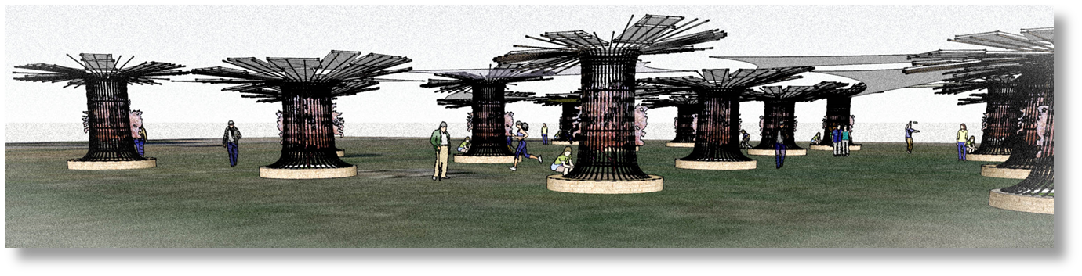
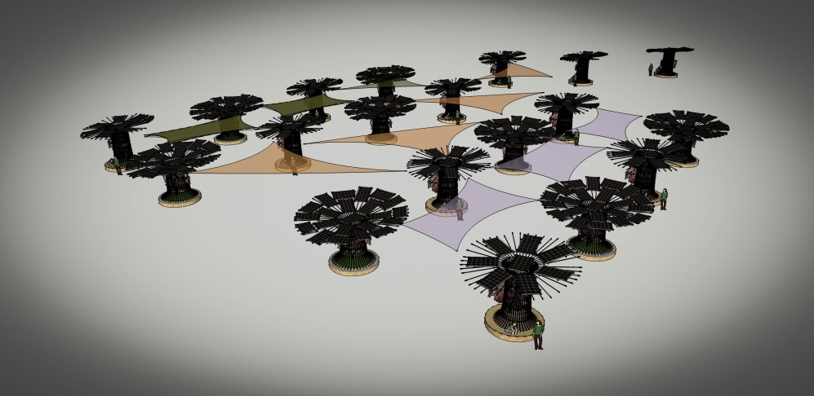
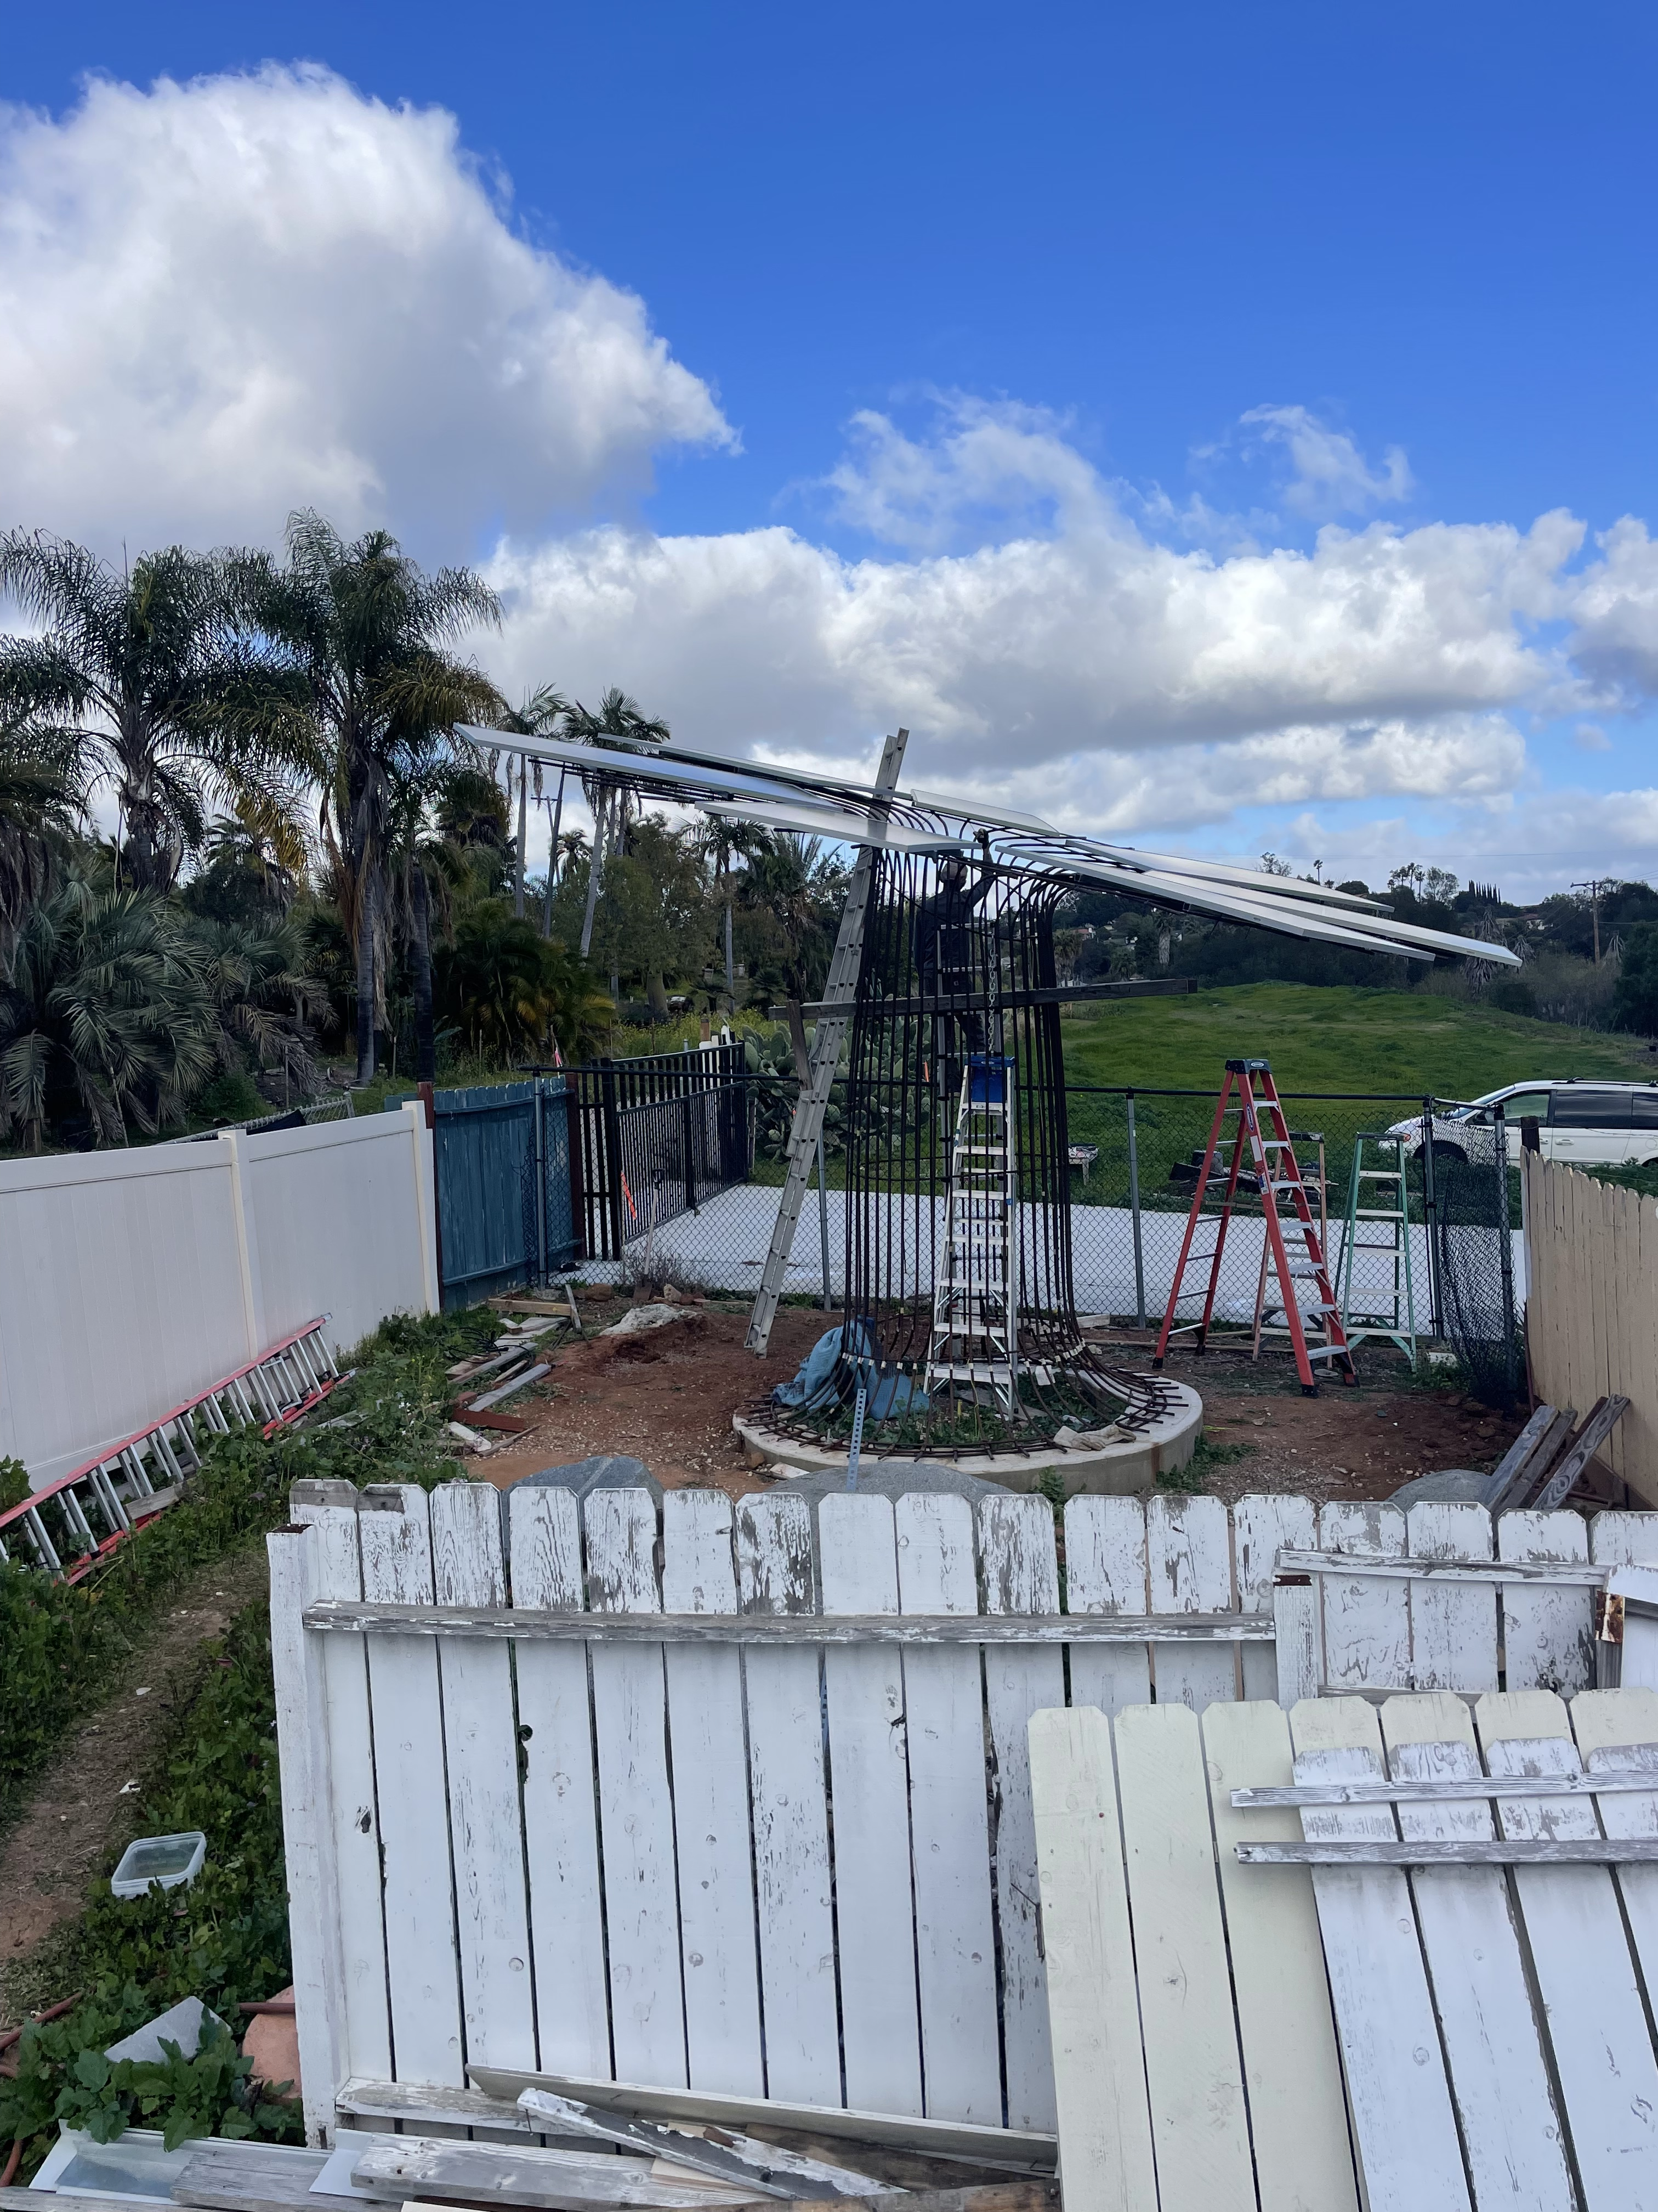
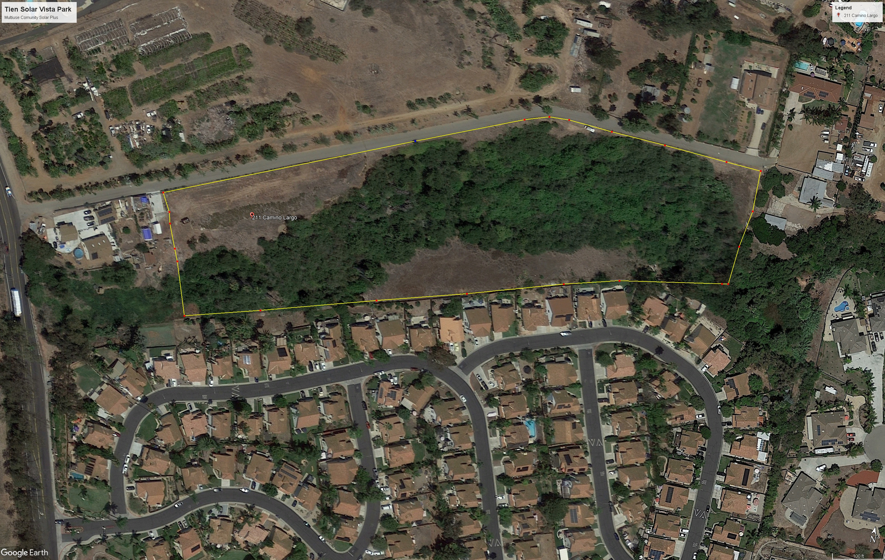
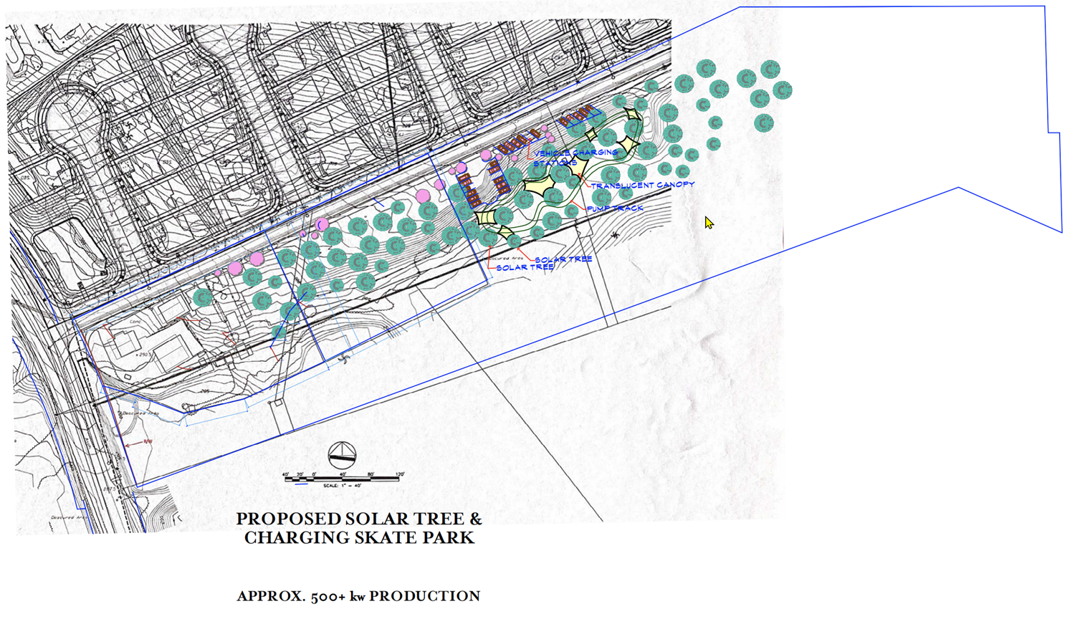
Marcone Solar Industries
Community Solartree Park, Vista CA
500 Kw SolarTree Park
Enables the space to be used for other activities like recreation
Completed first solartree – 03/01/2023
SolarTree Park
Solar Park Animation

