Slide 1
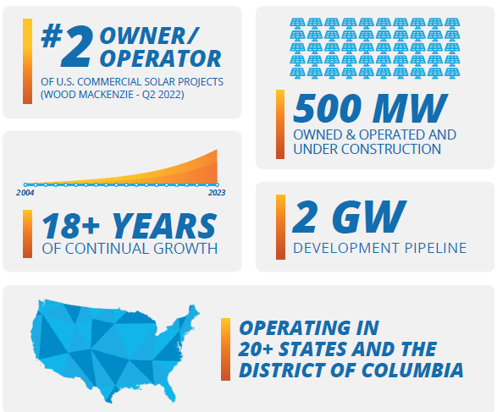

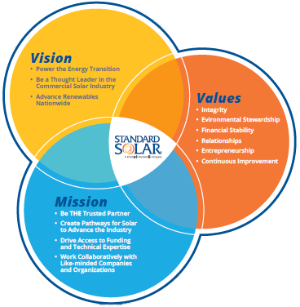
The Future Is Standard Solar
Standard Solar is a national leader, using resources and expertise to advance renewables through the development, funding, ownership and operation of commercial and community solar projects nationwide.
Our vision is to lead the solar industry by making energy accessible, affordable, and environmentally responsible.
Our 74MWac NCSP portfolio submission spans across the Mid-Atlantic, Northeast, and Southwest regions.
20 of 22 submitted projects meet at least 3 meaningful benefits, with 8 of them meeting 4 benefits.

