Slide 1
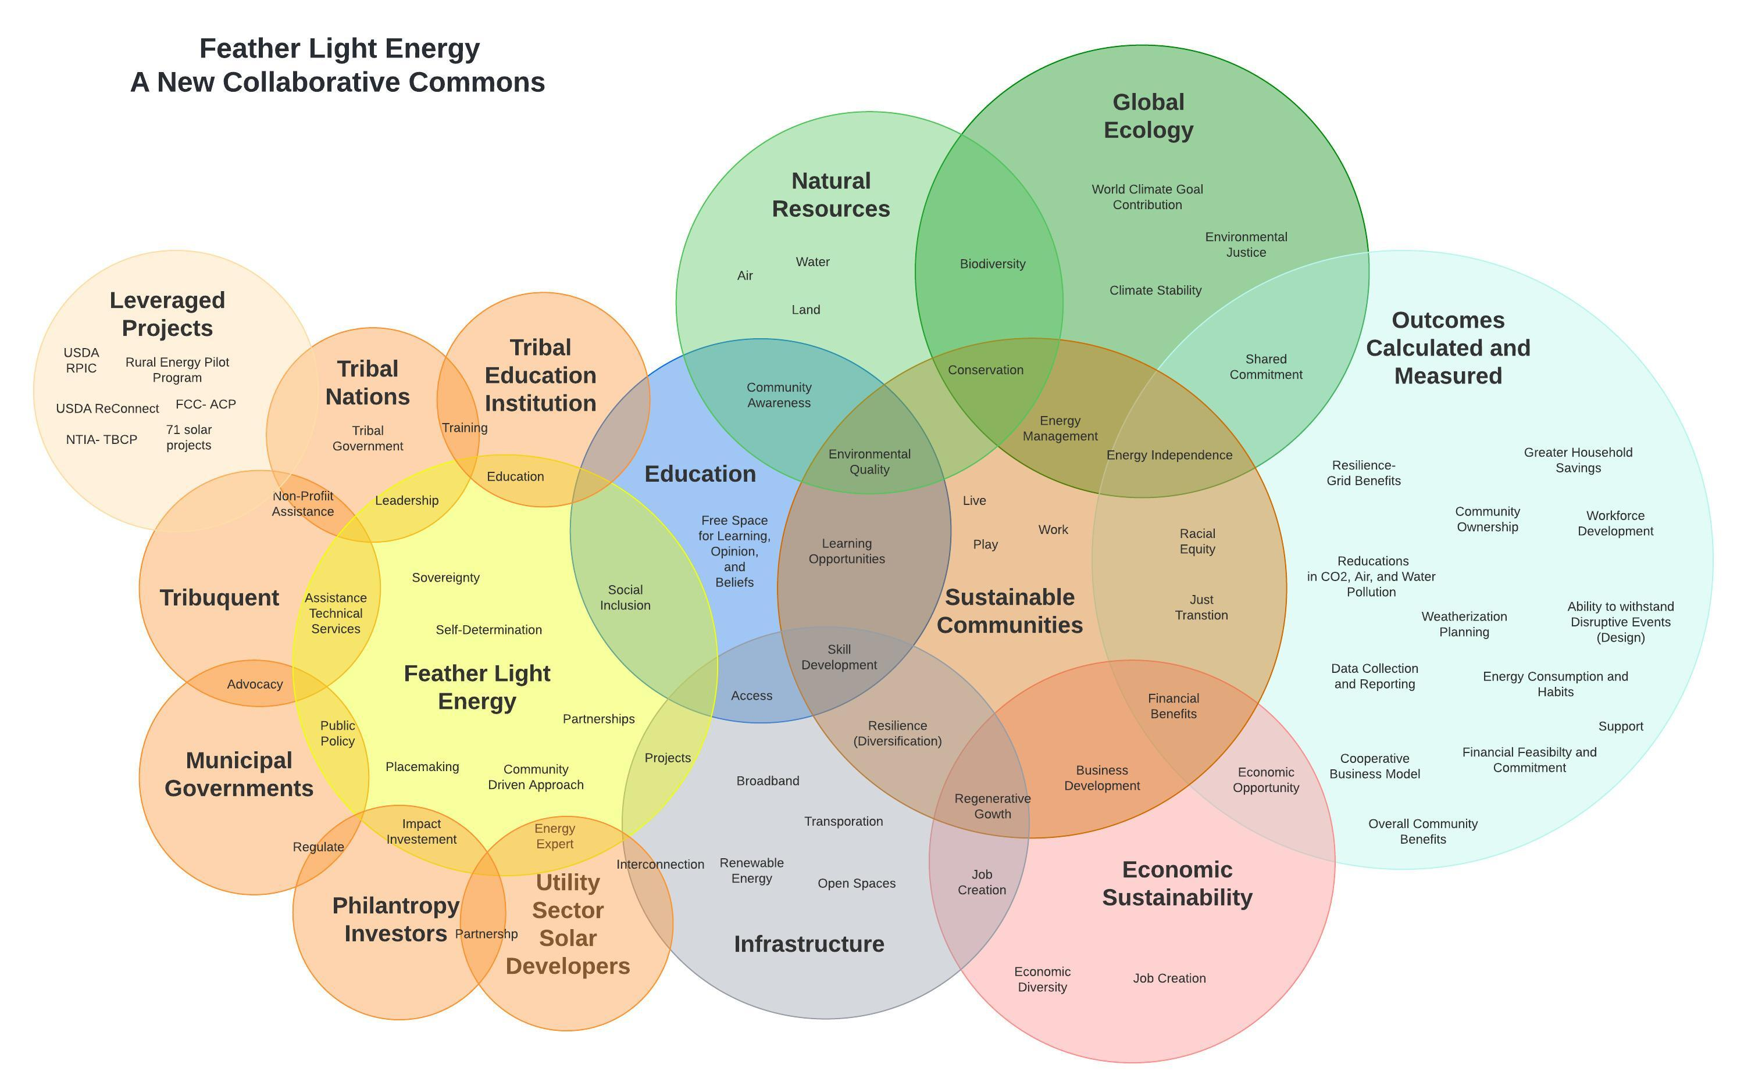
Tribuquent is on a mission to connect communities to a sustainable future. We see infrastructure as an organic relation between communications technologies and energy sources that together create a sustainable living economy.
Through the Feather Light Energy Project, we seek to build community resilience to restore, maintain and enhance community wellbeing based on cooperation, collaboration and partnerships.
Our approach to building sustainable communities come from understanding and working with different stakeholders while considering the infrastructure, natural resources, the global ecology, and the economy that surround us.
The “Tribuquent Team” is comprised of knowledgeable and skilled people within the areas of leadership, project management, engineering, planning, and seasoned solar development and installation. We represent a strong development team with vast and ample experience in the development and execution of community-based infrastructure projects that include solar energy.
Members are:
  Lyle Macvey: Executive Director Tribuquent
  Alexander Hessinger: Head of Sustainability & Economic Research Tribuquent
  Elliot Christensen: Director of Planning Department Lower Sioux Indian Community
  Jordan Kanuho: Vice President Pawnee Nation of Oklahoma
  Graham Christensen: Executive Director GC ReVOLT LLC
The following activities align with the five meaningful benefits and will be developed through the support of the Community Power Accelerator:
  Support tribal communities on building long-term vision on renewable energy to own and operate renewable energy infrastructure.
  Support tribal communities receiving educational and training opportunities on solar development/renewable energy/climate change
  Develop energy feasibility studies for tribal nations.
  Support technical design for community solar projects.
  Support financial sustainability/business modelling.
  Support Operational Status: localize key partners.
  Foster inter-tribal partnerships and shared models
Our planned portfolio has two initial solar gardens with up to 5MW within the Tribal Communities of Lower Sioux Indian Community of Minnesota and the Pawnee Nation of Oklahoma, with additional interest from 12 other Tribal Nations to develop their own community solar projects.

