Slide 1

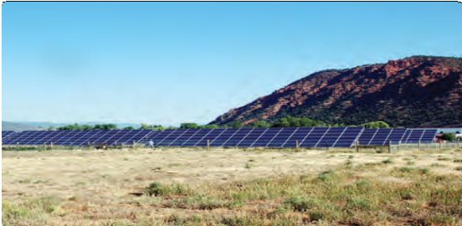
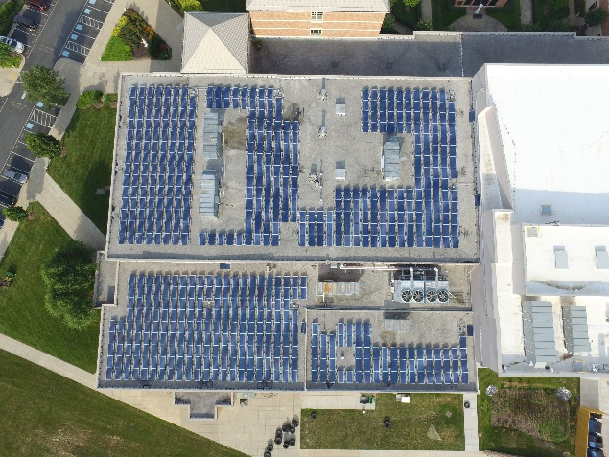

Profile
SPH Solutions specializes in the development, engineering, construction and financing of high-quality solar electric generation projects. We use the same proven approach for all our projects, from small to mid-size size commercial installations projects. Our clients rely on our extensive experience and expertise to develop turn-key solar energy systems that will deliver long-term performance to capture optimal results.
SPH Solutions develops cost-effective solar electric solutions mainly for non-profit entities (schools, religious entities, foundations) and also commercial, municipal, state and federal clients who demand high-end performance to capture the system’s long- term returns. SPH Solutions differentiates itself from the competition through outstanding past performance, premier design, engineering, project management expertise, and tailored financing solutions.
“QUALITY WITHOUT COMPROMISE.”
…the driving tenet practiced by SPH Solutions.
We are a seasoned solar energy owner , operator, developer and EPC
Our team of highly trained solar professionals is unmatched both in their qualifications, project execution, and dedication to client satisfaction.
COMPANY OVERVIEW
Founded in 2009
60 + installations
3 + MW of installed capacity
NABCEP Solar PV Installation Professionals™
Veteran Owned Service Disabled Small Business Certified
2
SPH Solutions LLC

