Slide 1

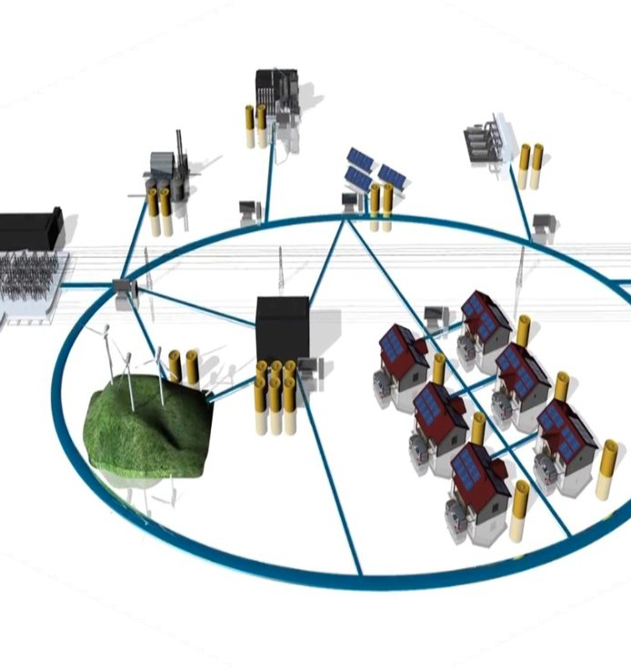

Seeking Communities Solar For Equity
La Margarita is a community-based organization located at Salinas, Puerto Rico.
Abeyno Coop is a certified Solar Cooperative by the Negociado de Energia de P.R.
Our main goal is to increase energy resiliency in our disadvantaged community creating a Solar Community project with at least 1 MW.
  Planning
  Ownership
  Education
  Implementation
Five Meaningful Benefits:
  Household Access for everyone including seniors, women, and low-income members.
  Photovoltaics system with battery backup grid-tied system.
  Reduce the cost of electric power services.
  Provide energy services in a continuous, stable, efficient and reliable manner.
  Educate residents of the advantages of renewable energy system and how to have ownership of the solar system.
Team's members:
Asociación de Residentes de La Margarita, Inc.
Cooperativa de Energía La Margarita – Abeyno Coop.

