Slide 1


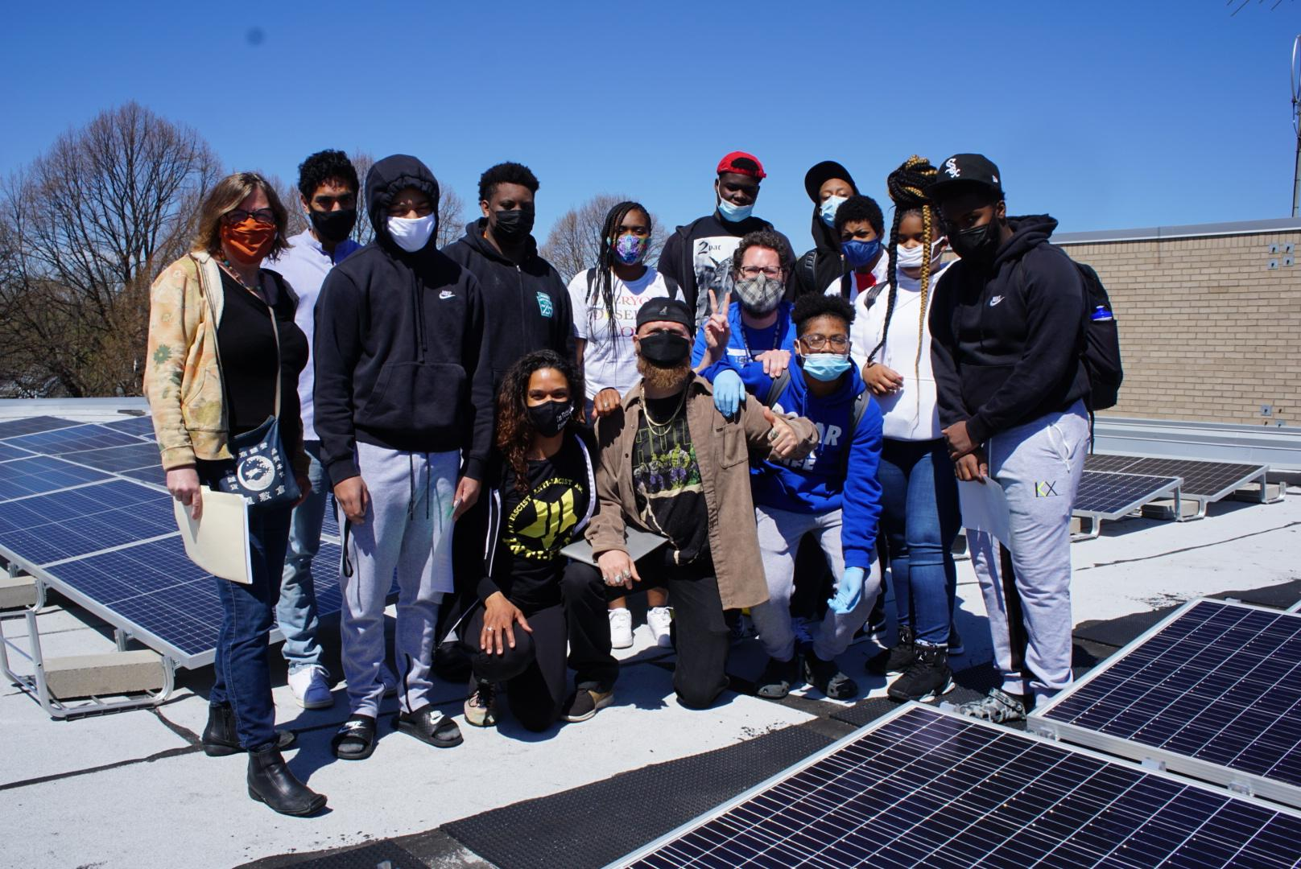
Powering our City, Empowering Our People
Community Solar as an Energy Democracy Tool
MInneapolis Climate Action and Renewable Energy Partners
CSG CAPACITY DEVELOPED by MCA and REP:
0.583 megawatts-dc with a waiting list of 141 people
50% LMI Subscriber pool (of those who voluntarily answered LMI status)
CSG DEVELOPMENT IN ACTIVE PROCESS:
3.434 megawatts-dc
CSG DEVELOPMENT GOALS:
Develop a Twin Cities network of 165 mw CSG capacity over the next three years
Average subscription for 25,000 LMI families of 6 kilowatts-dc each.
Net electric bill savings of more than $200 a year.
Increased awareness of energy and climate issues among LMI households
At least 60 local jobs for new NABCEP-certified trainees in solar energy skills
North Community High CSG, students and teachers
Community Power Accelerator Barriers to Bridges
Disadvantaged Community Engagement creates pathways to energy resilience, justice, green jobs
Minneapolis Climate Action and Renewable Energy Partners are ideal candidates for the
Community Power Accelerator Prize
Our communities are ready and waiting to lead in equitable community solar development!

