Slide 1
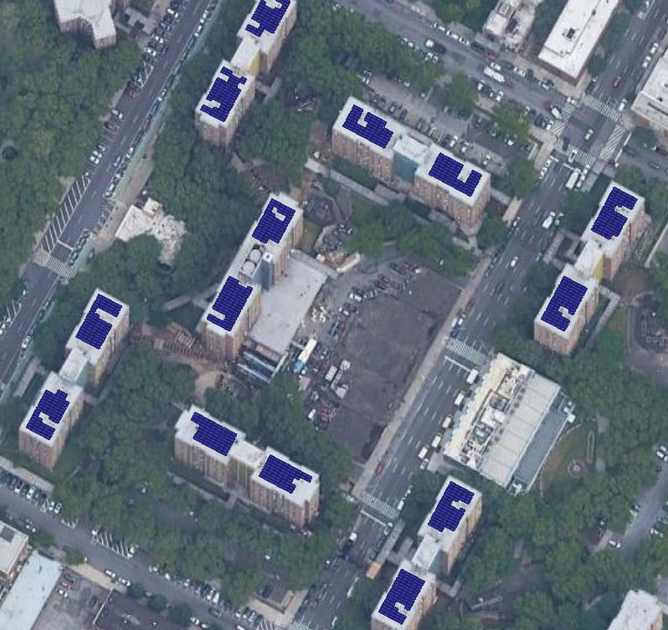
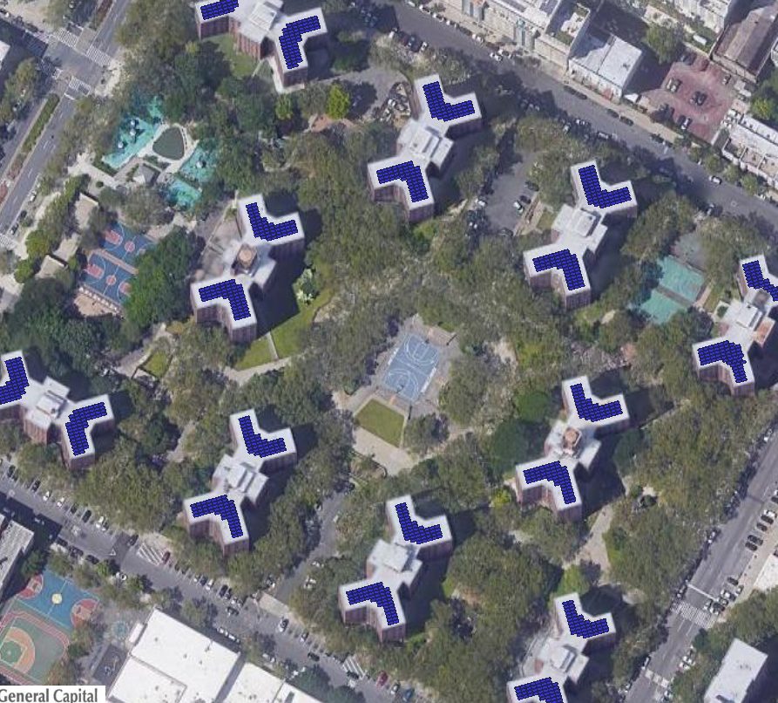
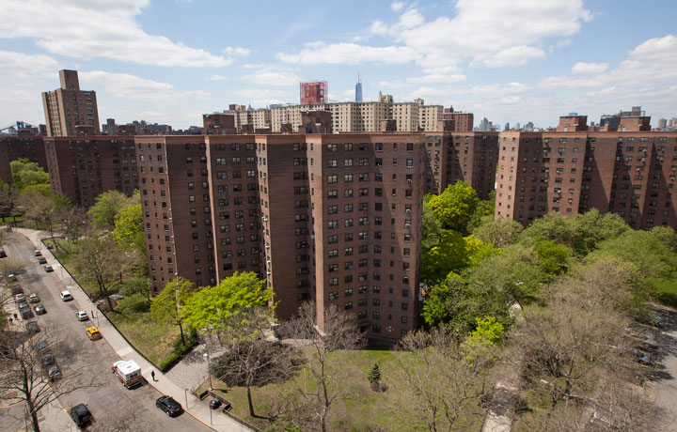
NYCHA Community Solar Projects
Community Solar projects serving NYCHA residents and local subscribers
Training, Workshops, Hiring of local NYCHA residents
Energy/Sustainability Career Fair
25% bill credit discount to LMI residents, 10% bill credit discount to non-LMI residents
Rent paid to NYCHA
17 buildings phase 1 – more buildings in phase 2
Current progress:
Development rights obtained from NYCHA
Interconnection applications submitted
EPC contract execution in progress
Roof and structural evaluations in progress

