Slide 1
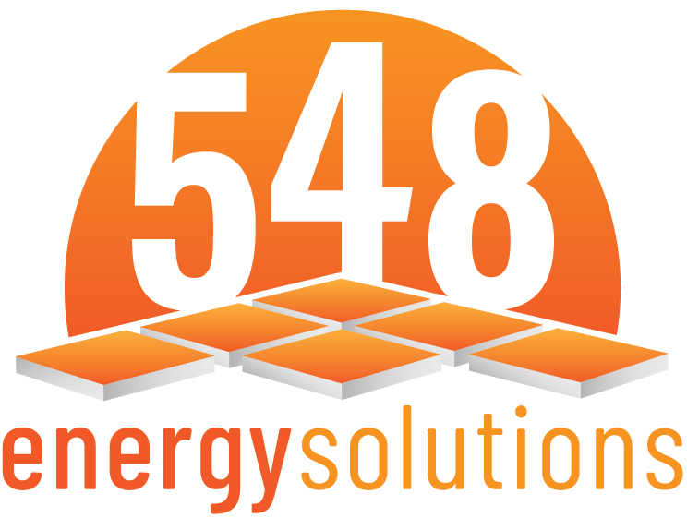
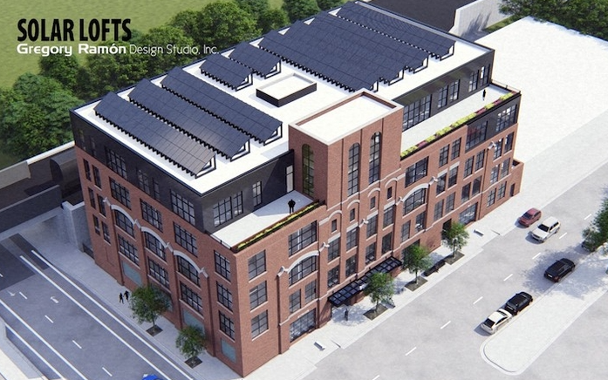
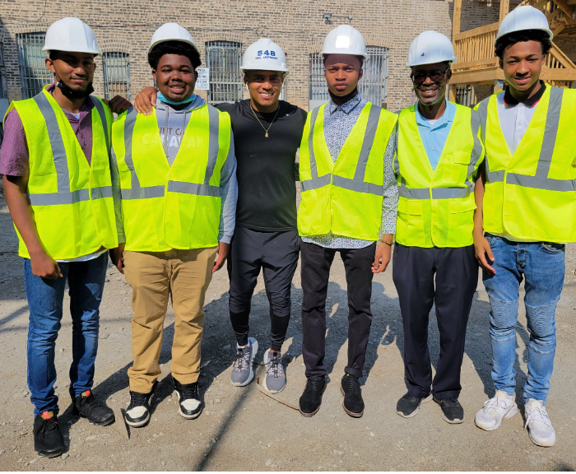
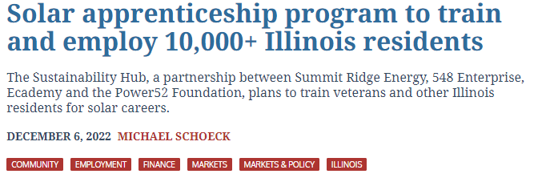
548 Energy Solutions: Affordable Power for Chicago
Development pipeline of 16 Chicago, IL solar projects (10.8 MW)
15 projects co-located with affordable housing
50% energy cost savings to subscribers
Integrated solar workforce training program, the Sustainability Hub
All projects offer meaningful benefits of LMI access, greater household savings, and equitable workforce development
In house real estate development team and affordable housing portfolio

