Slide 1



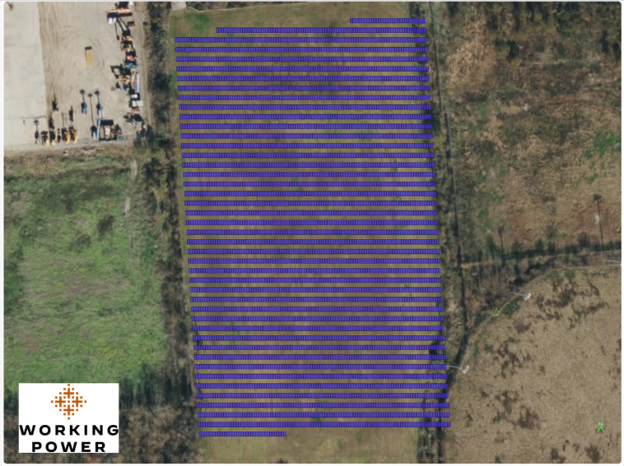
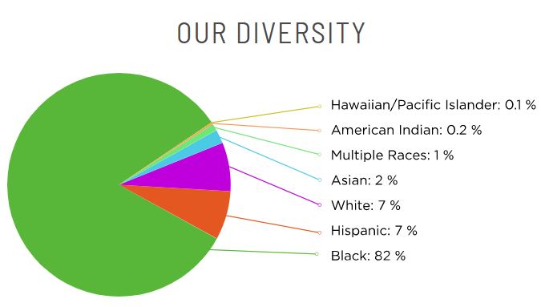
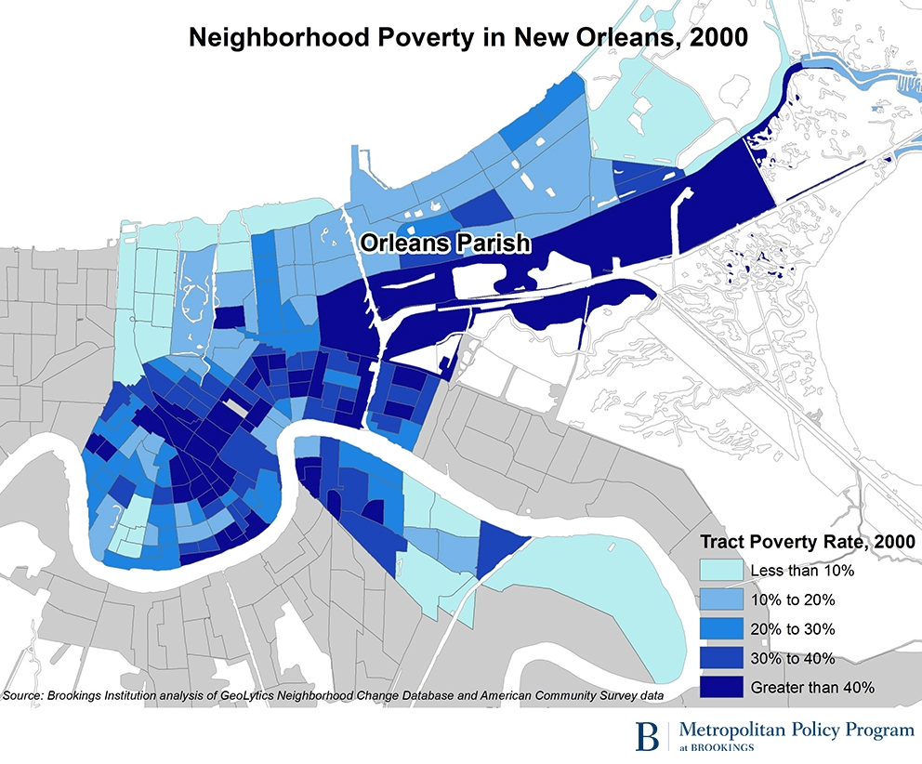
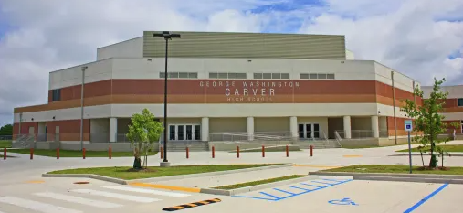
ABOUT
COST & BENEFITS
COMMUNITY ENGAGEMENT
  NOLA Public Schools (NOLA-PS) is a community of public schools for Orleans Parish School Board servicing over 45,000 students. Over 80% of students are economically disadvantaged. Our school system is home to the largest school recovery and construction program in the history of the United States; the School Facilities Master Plan (SFMP) included 70 schools rebuilt. Our experience includes green and sustainable construction: approximately 42 schools were constructed to LEED Silver standard and a few at LEED Gold Standard. Our team members include Green Coast Enterprises, which currently provides energy management services to our district and many schools; and Working Power / Urban Ingenuity, which brings experience developing community solar projects and will ensure that we can move these projects forward to completion.
NOLA-PS proposes to fund a “pilot” community solar site first under this application. The 2 MW project will be on G.W. Carver High School’s 35-acre parcel. Building on our experience from the pilot project, we would like to develop ground-mounted, community solar projects at three more schools with excess land: Livingston Collegiate Academy, Abramson Sci Academy, and Fannie C. Williams. With this prize and what we propose, NOLA-PS would create what we believe to be the first community solar project in the city. Additional project specifics and 25-year community benefits are:
NOLA-PS has deep experience engaging the community on facility construction and planning efforts. Over 10,000 individuals attended over 200 public meetings to develop the SFMP in 2008. Over 3,000 people participated in setting final goals for the 2011 SFMP amendments. We plan to recruit low-income families served by our school system and neighborhood residents as subscribers to our solar projects. Currently, community solar is one of the benefits we have presented to residents as part of our Surplus Property Strategy, in addition to other benefits such as educational support and services, affordable housing, early childhood education, workforce development and job training. We plan to hold specific meetings addressing solar development, design, and subscription opportunities as the projects come online.
50/50 community ownership
$1.1 M Community Ownership Dividend
2 MW community solar project
$1.8 M in energy cost savings assuming 15% discount
Approx. 570 NOLA-PS low-income student family households served
NOLA-PS will provide workforce development opportunities for students in our schools.
Grid resilience and school “resilience hubs” through battery storage
49,600 metric tons of CO2 equivalent avoided
$.46 M Total System Construction Cost
Community Owned Solar – G.W. Carver High School, New Orleans, LA
Notes:
details about the project: size, production, households served, energy savings, community benefit, etc.
recognition of the DOE meaningful community solar benefits that the prize will provide for the project:
LMI Household access
greater household savings
resilience and grid benefits
community ownership
equitable workforce development
information/ demographics about the community
information about the community group and goals for community solar
logos of community group and UI and WP + some proposals have other partners.

