Slide 1

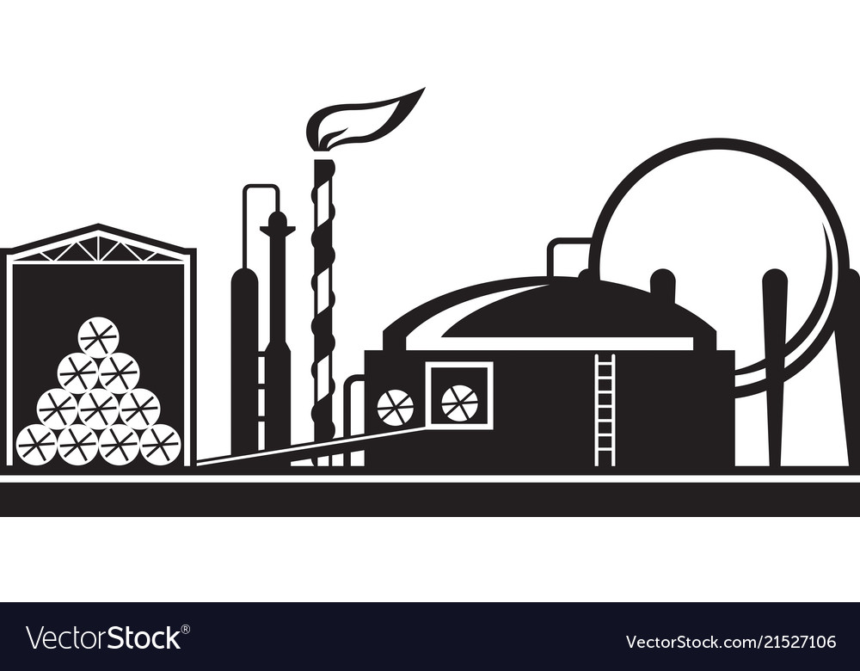
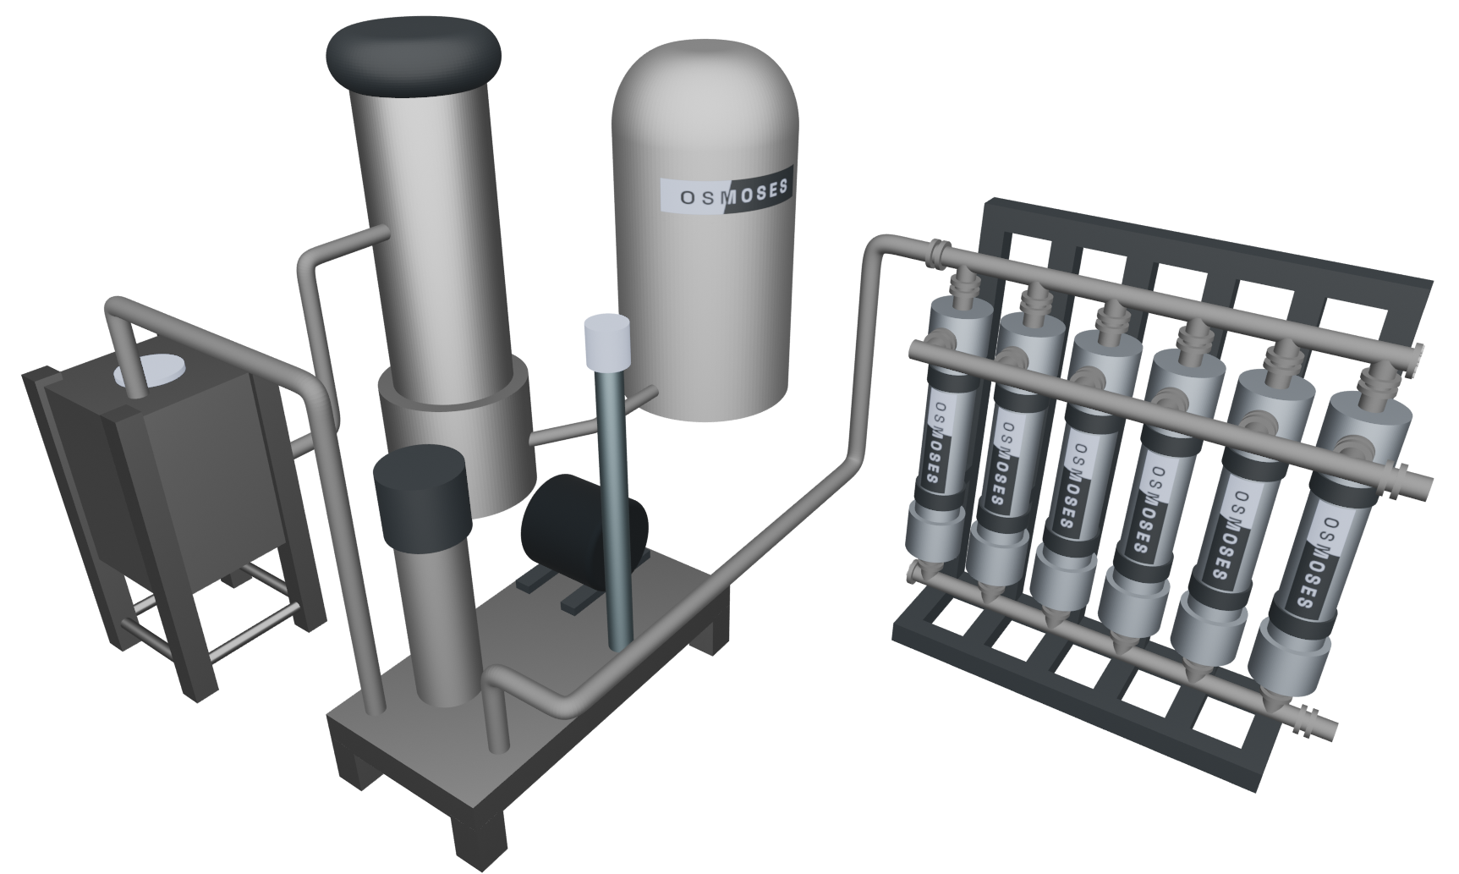
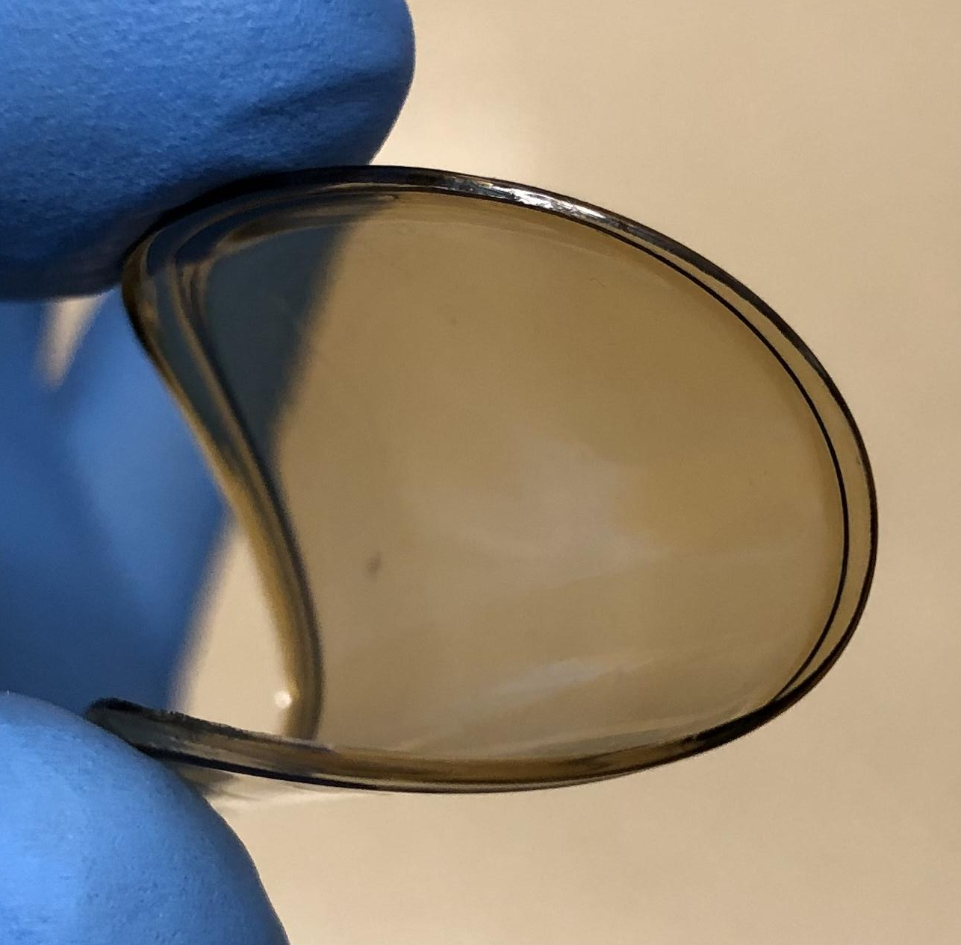
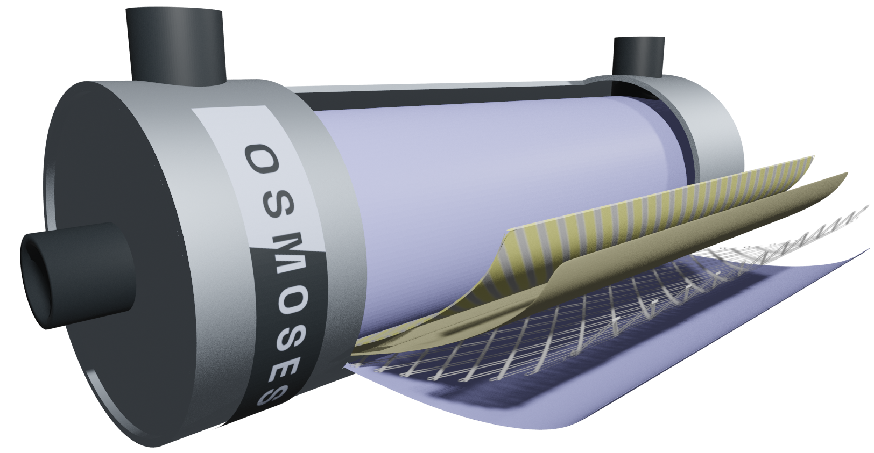
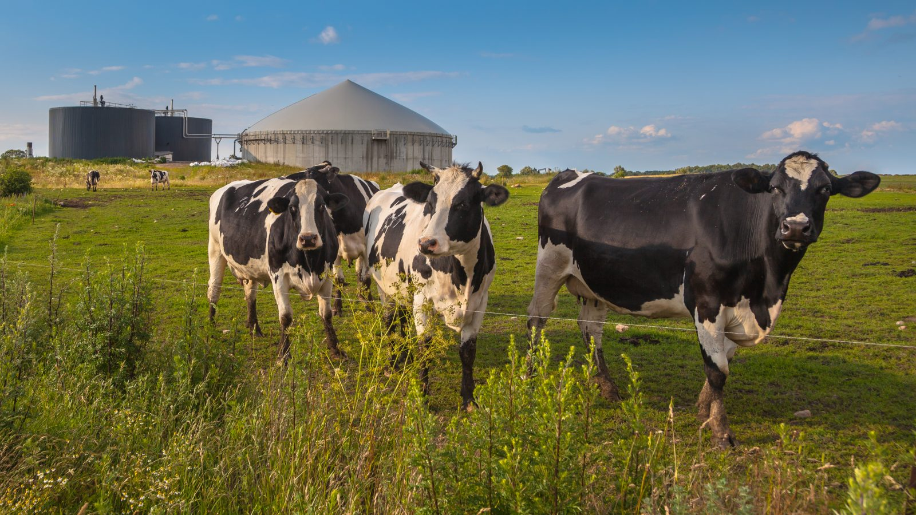
Providing scalable and efficient separations for a hydrogen economy
Osmoses innovation
Compact membrane module
Osmoses molecular filters
Renewable natural gas (RNG) or H₂/CO₂ reactor effluent
Membrane skid
Biomethane can be produced from carbon-neutral feedstocks using Osmoses membrane technology
After reacting biomethane to form hydrogen, H₂ can be purified for use
Further CO₂ capture and sequestration could be pursued to achieve carbon-negative H₂ production
Membrane pumps can be powered by clean and renewable electricity, further reducing environmental impact
© 2022 Osmoses | info@osmoses.com

