Slide 1
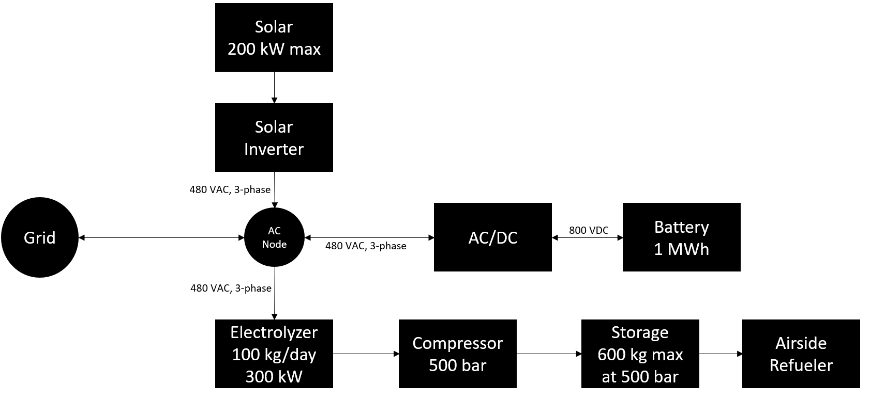
Hollister Hydrogen Hub (H-3) Project
Project Summary
A system-of-systems optimisation to combine software control, a 300 kW proton exchange membrane (PEM) electrolyzer, a 1 MWh battery bank, a 240 kW solar plant, and bidirectional grid to produce the cheapest-possible hydrogen for direct-use aviation applications.
How does it contribute to U.S. Department of Energy Goals?
H-3 Project advances DOE goals in regards to (1) Decarbonization (through hydrogen production method and end-use), (2) Reliability (through grid stabilization and frequency regulation), and (3) Energy Justice (through reducing burdens on airport communities).
Hydrogen is critical to meeting the Biden Administration Goal of achieving a 20% reduction in aviation emissions by 2030. When used in direct on-board fuel cell applications, it produces zero tailpipe CO₂, no NOx, and significantly reduced water vapor and contrails when compared to Sustainable Aviation Fuels (SAFs) or direct hydrogen combustion.
A successful pilot project demonstrating the system integration and cost avoidance described to the left is critical to progressing towards Hydrogen Shot goals of $1 per kilogram of hydrogen by 2030.
What’s the innovation?
End-use of Hydrogen Produced: Hydrogen use today is dominated by industry, namely: oil refining, ammonia production, methanol production and steel production. This will be a first-of-a-kind project to produce hydrogen on-site for direct use in aviation (hydrogen-electric propulsion). The aim is also to use a new technology electrolyzer with reduced iridium and platinum thus reducing cost and materials intensity. We also intend to containerize infrastructure to the extent possible to reduce installed CAPEX costs.
Avoiding Transportation and Distribution Costs: The H-3 Project will be producing hydrogen at the site of the offtaker. On-site production only results in a conversion/transmission cost of 0.5 USD/kg H₂ and no distribution cost. This approach not only lowers the overall levelized delivered cost of hydrogen, but also allows for the offtaker to contract green hydrogen supply at the most competitive price possible.
AI-powered system integration: A software-optimized system (lowest cost, lowest emissions) involving renewable energy, hydrogen production and storage, battery storage, and a grid connection has never been demonstrated at pilot scale.
Grid-stability, Energy Storage, Decarbonization Services:
  By combining hydrogen with battery storage, one mitigates drawbacks from each technology operating alone.
  Excess energy from the project can be deployed back to the grid for compensation (low-emission Demand Response, additional revenue stream to buy down levelized cost of production).
What will the project look like?

