Slide 1
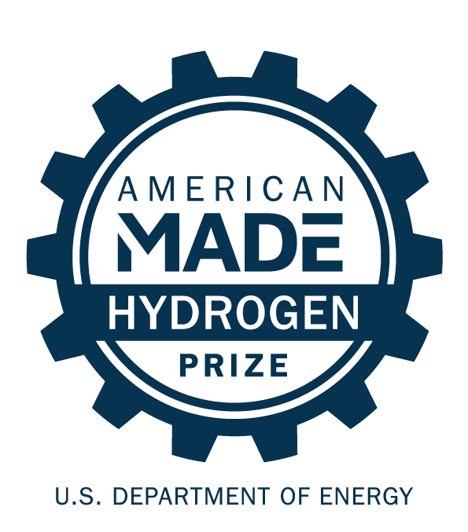
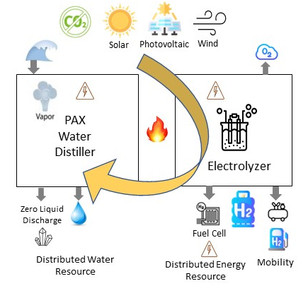
PAX H₂(o)
Lower hydrogen costs by purifying water
www.paxscientific.com
PAX H₂(O) can help make the Hydrogen Shot 1-1-1 goal a reality for communities of all sizes!
Our solution integrates with hydrogen electrolyzers to reduce CAPEX and OPEX while distilling pure water using the heat from the electrolysis process.
PAX H₂(O) combines electrolyzers with solar and/or wind photovoltaic energy and our optimized distillation system to lower the price of clean hydrogen production by $.07 per kg.
PAX H₂(O) works even at smaller scale and purifies not just seawater and brackish waters cleaned by reverse osmosis, but highly saline and contaminated waters that reverse osmosis can’t handle. It solves water scarcity for electrolyzers and beyond.
We’re a nature-inspired engineering firm based in Richmond, California – an ideal place to grow an inclusive energy company.

