Slide 1
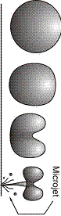
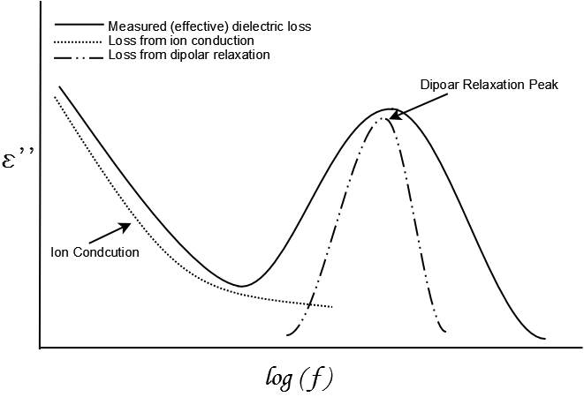
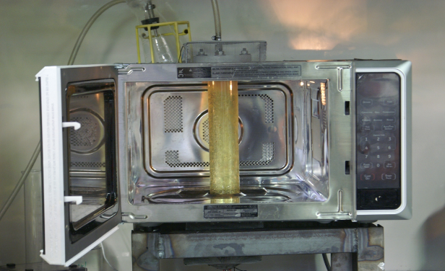
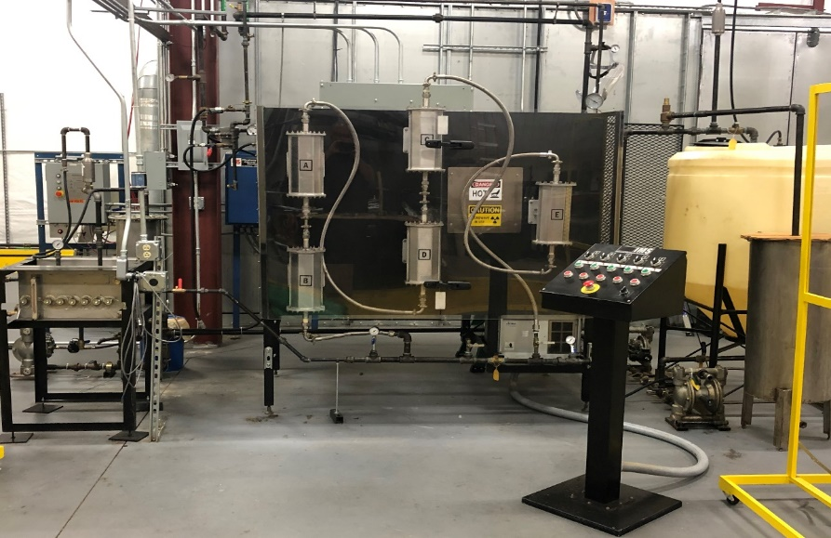

Multi Energy Optimized Processing (MEOP)
for Hydrogen Production
Ultrasonic Cavitation
Microwave Heating
Prevents fouling of heterogenous catalyst and membranes
Maximize mass transport, homogeneity
Efficiency through targeted absorption
Permits super-heated reactions
Directs energy to break hydrogen bonding between H₂O molecules
Technology Scale-Up demonstrated
Commercial Implementation

