Slide 1
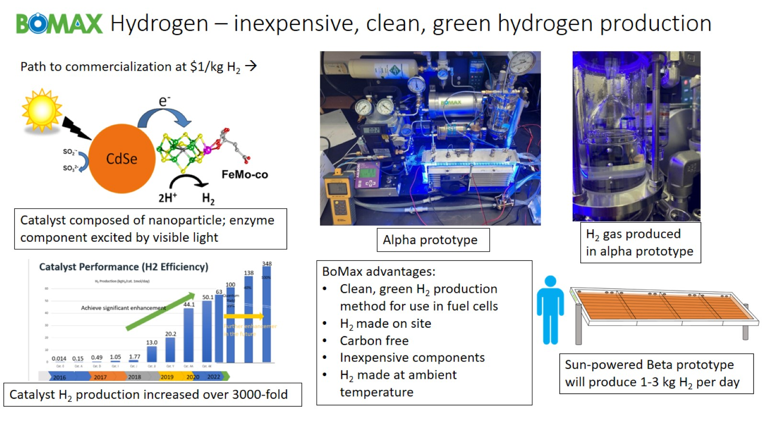
BoMax Hydrogen – inexpensive, clean, green hydrogen production

