Slide 1


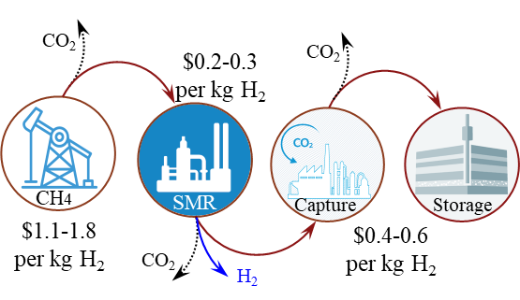

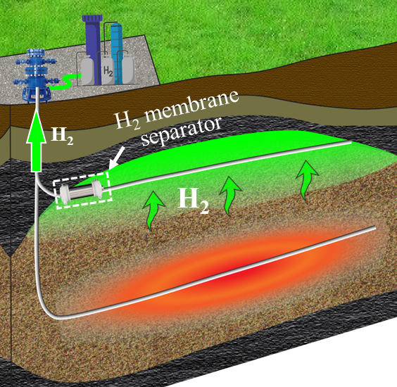
Low-Cost, Clean Hydrogen Generation from Depleted Natural Gas Reservoirs
via In-Situ Microwave-Assisted Catalytic Heating
Challenges: Steam Methane Reforming (SMR)
New Concept: In-Situ Hydrogen Generation via Microwave-Assisted Catalytic Heating
20% H₂ generation in oil reservoirs
Above ground: 99.8% H₂ from CH₄ cracking via microwave heating, with less than 0.2% CO₂
Microwave heating for reservoir-scale oil recovery has been conducted
Technically achievable
Potential to Achieve DOE’s Goals:
Negligible CO₂ → CCUS is not needed
Re-use existing infrastructures in oil and gas fields (millions of abandoned wells in the USA are available)
Challenges:
Hard to further reduce the cost significantly
10 times more CO₂ than H₂
H₂
Significantly reduce H₂ cost
Easy scaleup
Expectations of new technologies:
Net-zero carbon emission
Potential to reduce cost to < $1/kg H₂ in 1 decade
The Hope Group: Qingwang Yuan, Jacob Stephens, Keju Yan, and Daniel Solorzano
Website: www.TheHopeGroup.Tech • Email: Qingwang.Yuan@ttu.edu
Mission: Repurposing assets of petroleum industry to accelerate energy transition by opening new pathways to low-cost, large-scale, clean hydrogen to the society.

