Slide 1
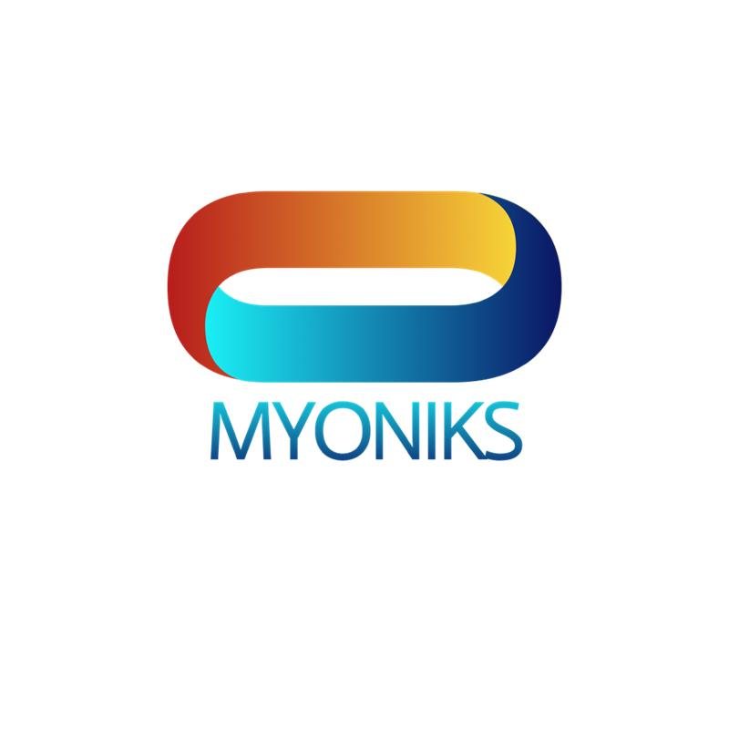
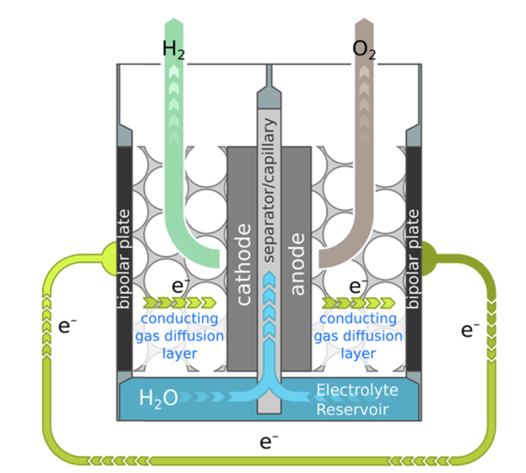
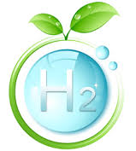
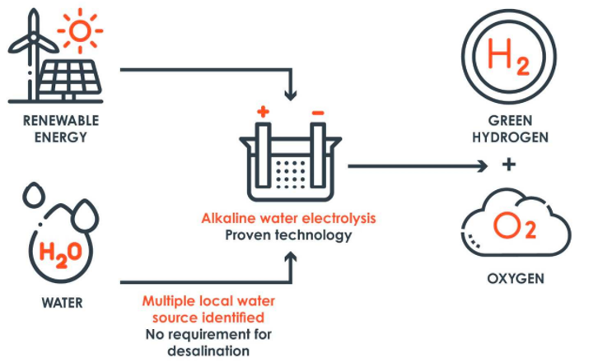
High-Efficiency Hydrolyzer
Myoniks Inc, is a HUBZone minority woman owned small business has a team of professionals that is determined to achieve our company’s vision by leveraging its in-depth knowledge and experience to produce solutions for clean and sustainable energy. Since the energy crises of the 1970s, hydrogen has gained appeal as a fuel source and has demonstrated its viability as the "Fuel of the Future." However, the price of producing Hydrogen fuel is the main barrier. Myoniks Inc., has developed the innovative technology for producing hydrogen without emitting greenhouse gasses. In order to make the price of the generated hydrogen competitive with that of traditional transportation fuels, Myoniks Inc., has an extremely efficient (98%) hydrolyzer using Poly-Ether Sulfone (PES) Separator
Myoniks’ Hydrolyzer generates an O₂ byproduct which can be sold for industrial and medical applications.
Myoniks will use the funds to build a prototype capillary-fed electrolyzer (CFE) which consumes ~47.5 kWh kg⁻¹ H₂ that represents a 98% efficiency.
Myoniks has customers lined up to purchase this product as part of its fuel cell package since the hydrogen fuel cost is projected to be $0.96/kg.

