Slide 1
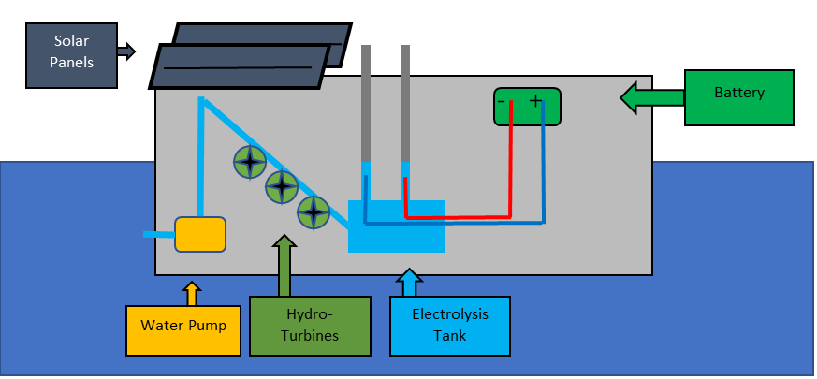
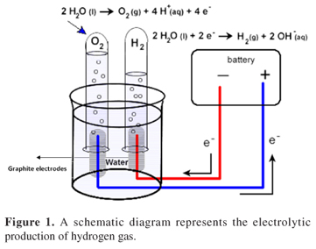

Hydro-Barge
Hydrogen Shot Incubator
Proposal
Commercialized

