Slide 1


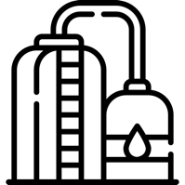
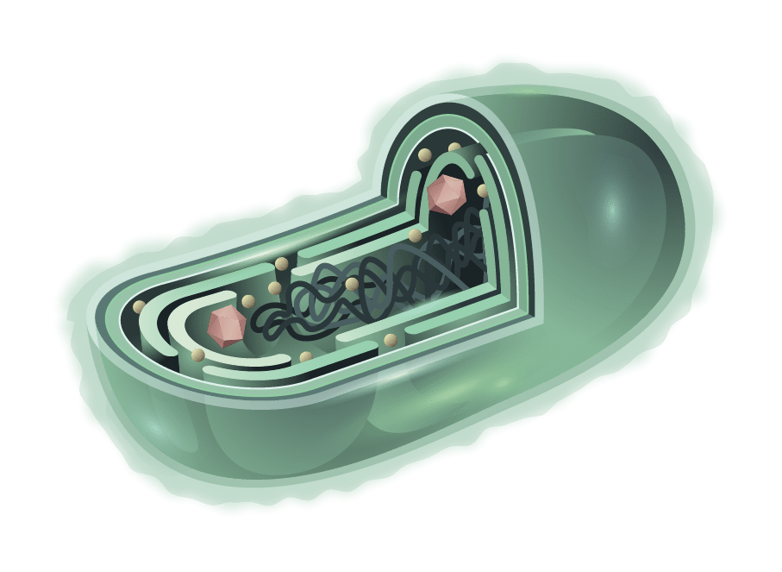

Subsurface Production of Clean Hydrogen
Gold
Hydrogen
Produced biologically
In the subsurface
Recycled water, microbes, nutrients, and/or inhibitors
Gold H₂ Processing
H₂ Offtake
H₂
CO₂*
Hydrocarbon Fermentation
*Currently evaluating methods to keep CO₂ in the ground while allowing H₂ to be produced

