Slide 1

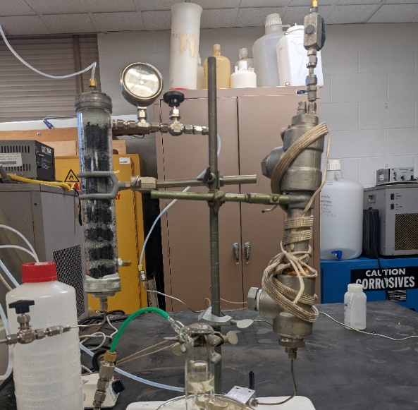

Efficient Thermo-Catalytic Production of Green H₂
Team Members: Dr. David Ryan, and Dr. Elizabeth Farrell
In a novel discovery by our team, nanostructured nickel catalysts have been found to produce H₂ from water in a low-temperature thermo-catalytic reaction by the conversion of CO₂ with H₂O to formic acid, and the subsequent degradation of formic acid to H₂ & CO₂
Dual-Reactor System for H₂ Production
Production of Formic Acid
Degradation of Formic Acid
$$CO2+2H2O→HCOOH+2OH−$$
$$HCOOH→CO2+H2$$
Catalytic Redox Reaction producing a variety of valuable by-products such as perchlorate from chloride, formic acid from glucose, and nitrate from nitrogen
Carbon-neutral reaction, but results indicate degradation is producing HCO₃⁻
Less CO₂ is being produced than consumed, leading to a net negative CO₂ reaction
Separation of the two reactions allows storage of formic acid, rather than hydrogen

