Slide 1

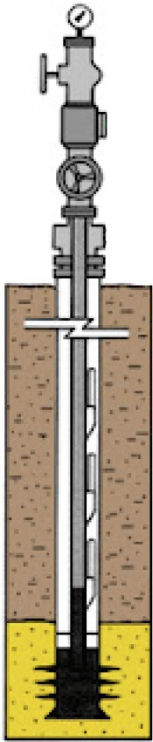
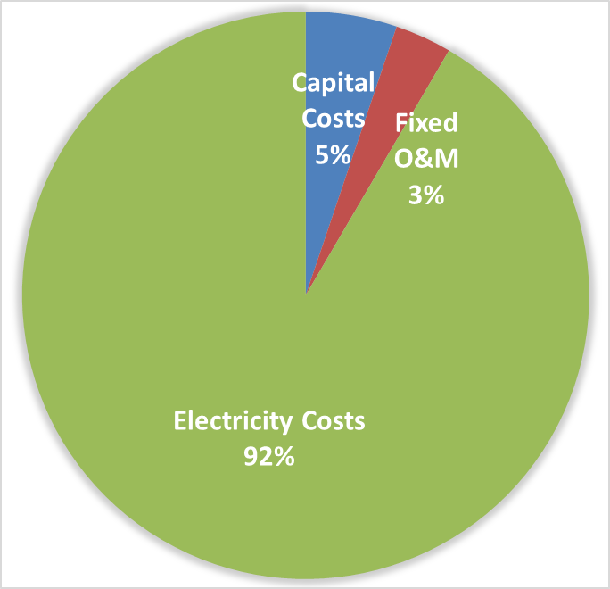
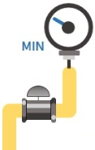

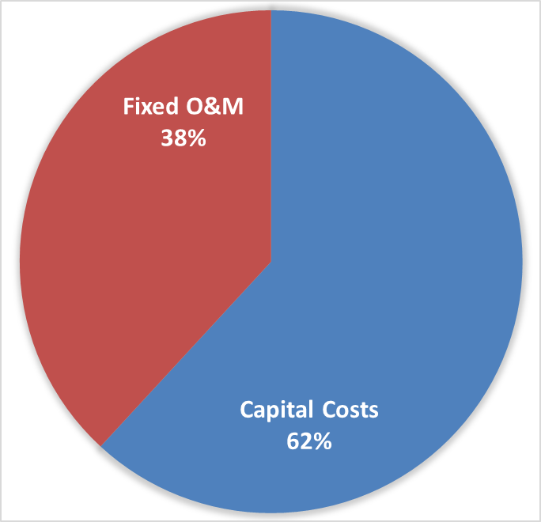

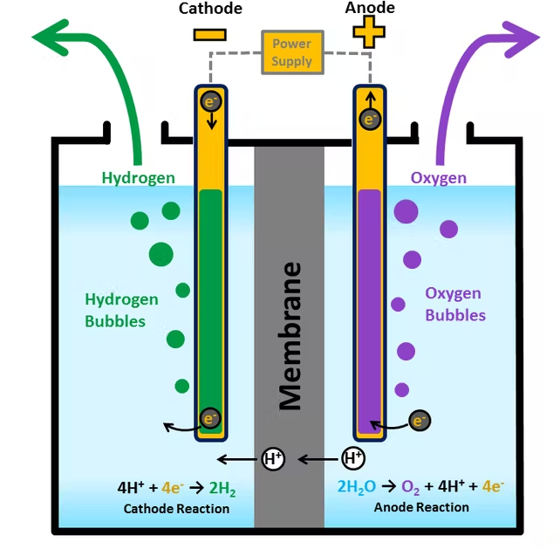
PEM Electrolysis Powered by Geological Pressure
    Organic Generation’s Geologic pressure Generator
    Problem: PEM Electrolysis requires significant amount of electricity
Gas Feed
    PEM Electrolysis unit cost is 67% electricity
    Renewable energy is inconsistent and expensive
    Fossil fuel energy produces emissions
    Energy transportation creates logistical complications
$4.48 / kg H2
$4.58 / kg H2
    Solution: Utilize geologic pressure create clean, low-cost energy
Geologic Pressure Generator
Gas Distribution
    Six horizontal hydrocarbon wells have the equivalent pressure of the water behind the Hoover Dam
    Capital cost increase is significantly less than electricity savings
    Zero emissions and minimal footprint created
$1.34 / kg H2
Electric Power
Pressure from oil and gas wells is plentiful and underutilized. Converting the pressure energy to electrical energy allows for clean energy that has little operating costs, uninterruptable, and a small footprint.
GAS USERS
PEM Electrolysis
Notes:
ASSUMED SHARE PRICE: $11
SHARE COUNT: 224.486
Add cash operating margin next to Operating Margin. Footnote what cash operating margin means.

