Slide 1
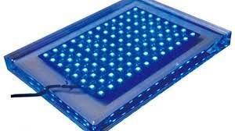
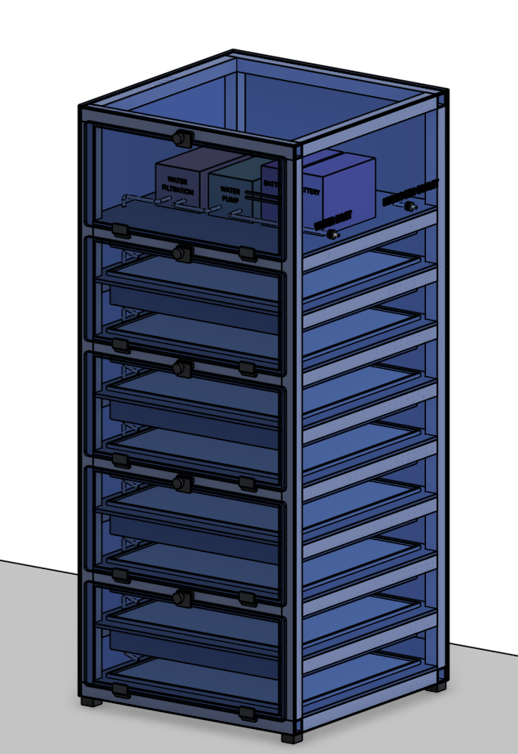
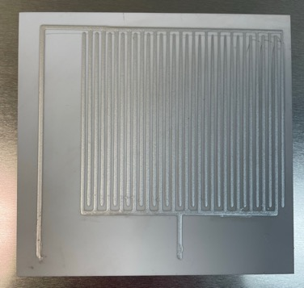
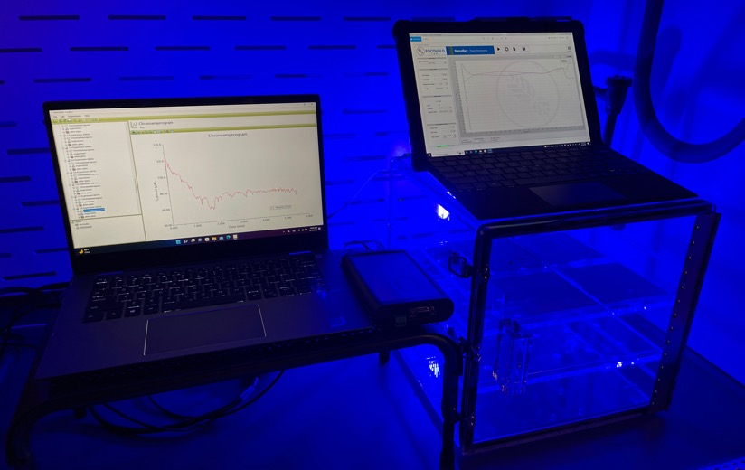
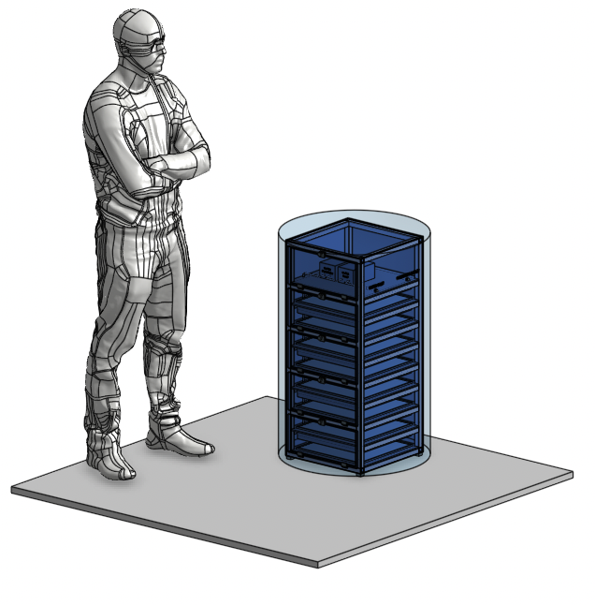
Small Form Factor Reactors – Power Tile Design Concept
Water
Input
Solar / Battery Bank Electrical Input
Hydrogen
Output
532nm Wavelength Blue Light Arrays
Hydrogen Reactor
Designed To Fit In 55 gal. barrel for off-grid transport
Print conductive ink on 24 x 24” ceramic tiles
Power Tile
Proof of Concept Reactor (24”x 18”)

