Slide 1
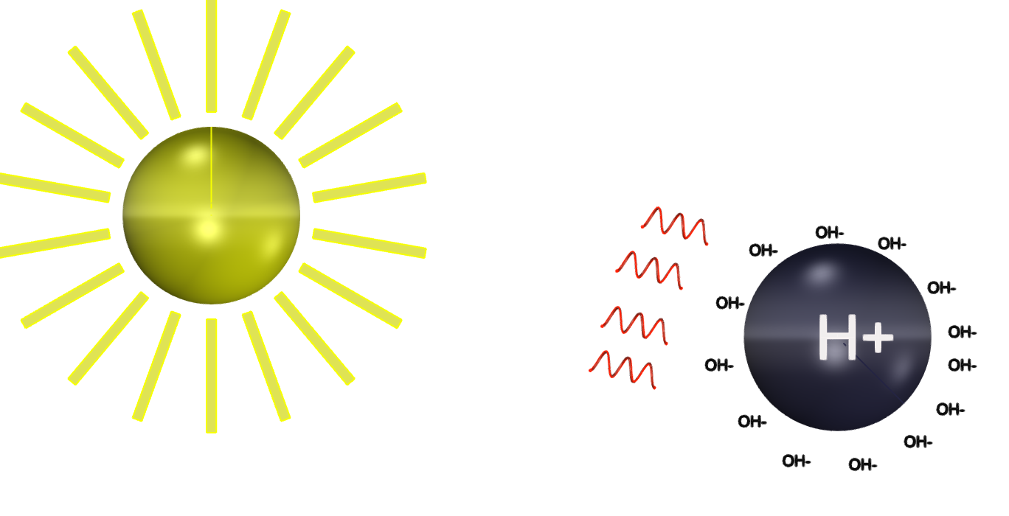
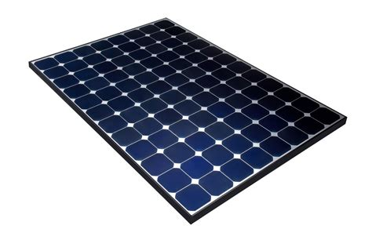
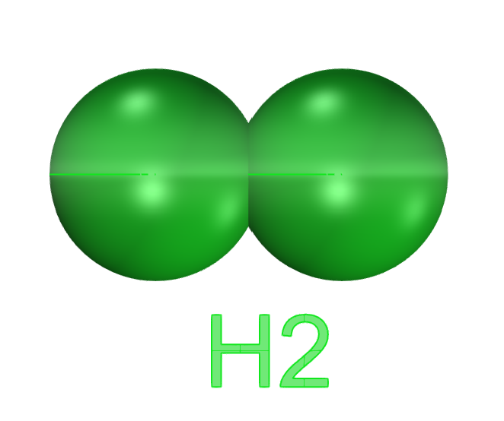
100% Carbon free clean Hydrogen
0.4 volts from Nafion photon charged boundary layer.
0.83 volts solar
32% lower electrolysis power cost
5 Micron spheres of Nafion in water produce a 64,000-fold increase in surface area photon induced electrical charge compared to a flat panel per unit area of exposed sunlight.
Lower Capex = faster amortization = quickest path to sub $1 per kg Hydrogen

