Slide 1


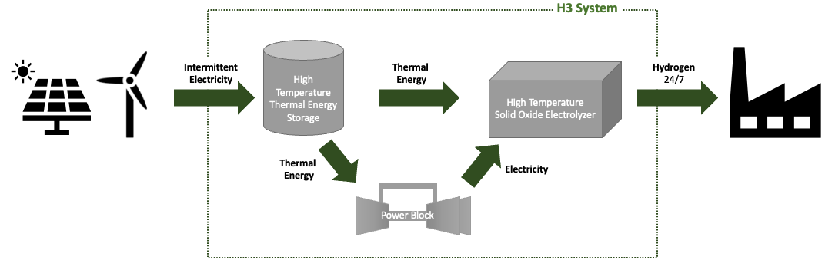
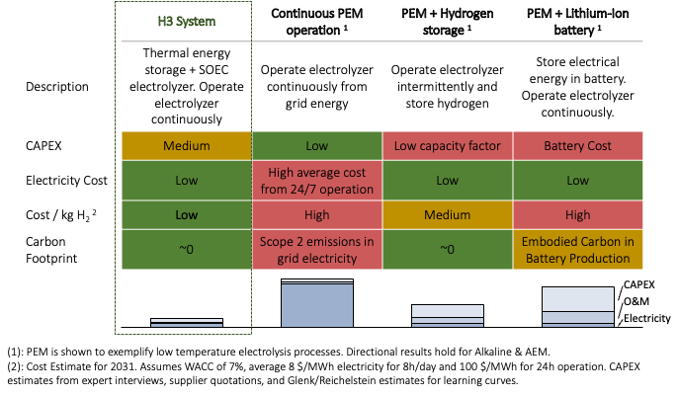
H3’s projected cost of hydrogen production is $2.50-2.80/kg in 2026 and $0.95-1.10/kg in 2031², achieving the DoE’s Hydrogen Shot through:
LOW ELECTRICITY COST
HIGH UTILIZATION
H3 accelerates the decarbonization of heavy industry through green hydrogen. By decoupling hydrogen production from electricity input, the system enables continuous hydrogen production from an intermittent energy source. This significantly reduces the production cost of green hydrogen at scale.
Using intermittent renewable electricity at low cost or when otherwise curtailed, to minimize cost
Integrated storage enables H2 production around the clock (~100% capacity factor)
In a direct comparison with alternative electrolytic pathways to produce green hydrogen for continuous off-takers (>90% of the hydrogen market today) H3’s system is the lowest cost pathway
The H3 system consists of three primary components
High-Temperature Thermal Energy Storage (TES): Sensible heat is stored at ~850°C in rock-like thermal mass. Lowest cost energy storage solution ($5-20/kWh) with significant synergies in process integration
Power Block: Thermal to electrical energy conversion using a supercritical CO₂ closed Brayton cycle with ~60% conversion efficiency
Solid Oxide Electrolyzer (SOEC): High-temperature electrolyzer (operating at ~820°C) with electrical efficiency up to ~100-115% H2 HHV dependent on mode of operation (vs ~80% for PEM)

