Slide 1
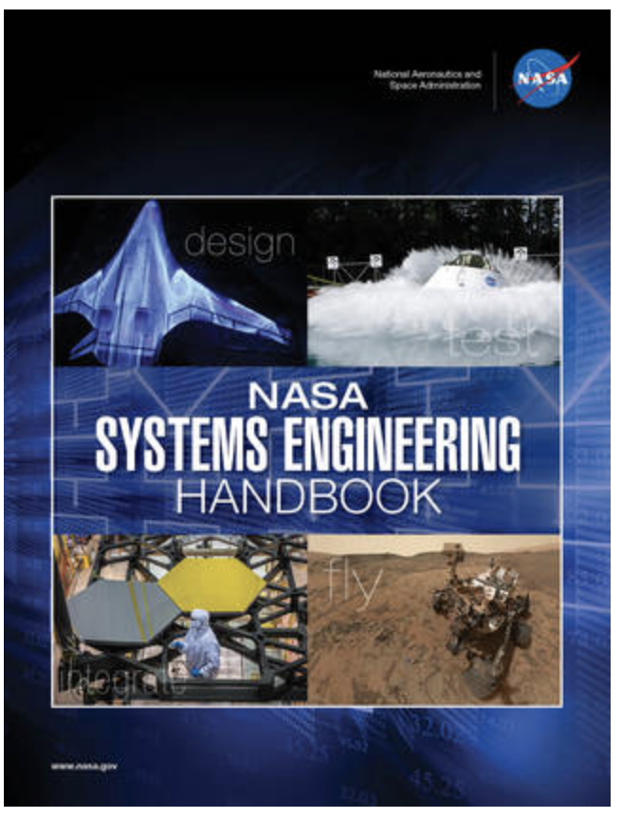
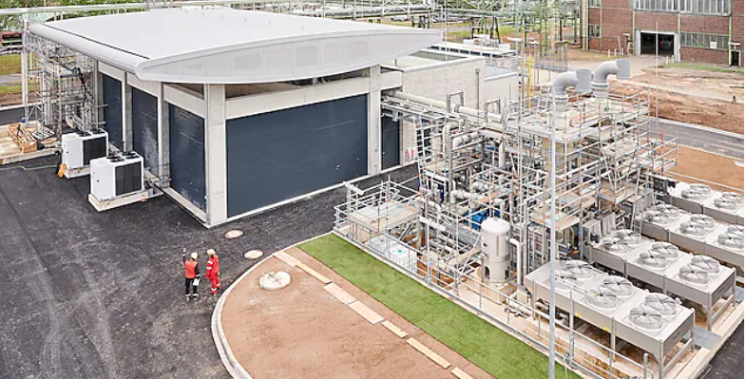

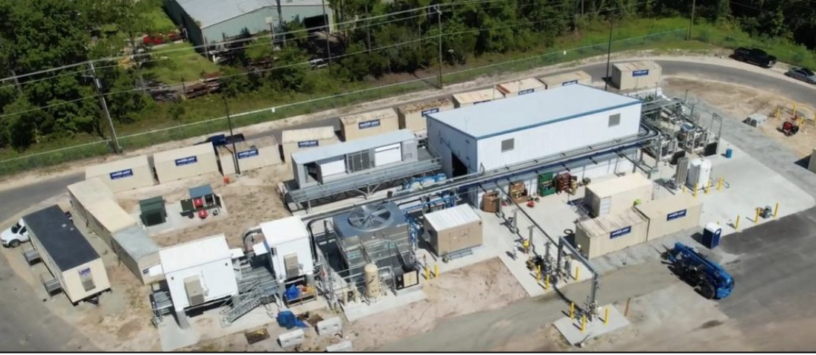
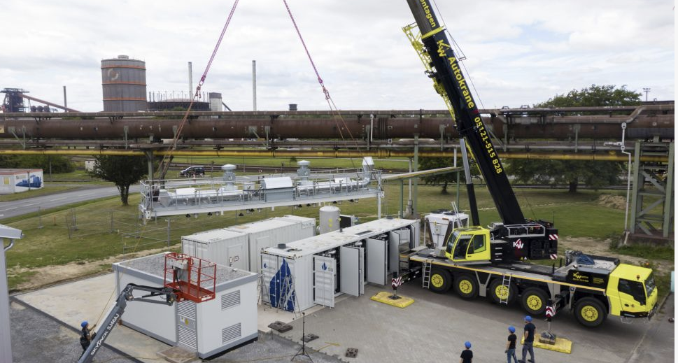
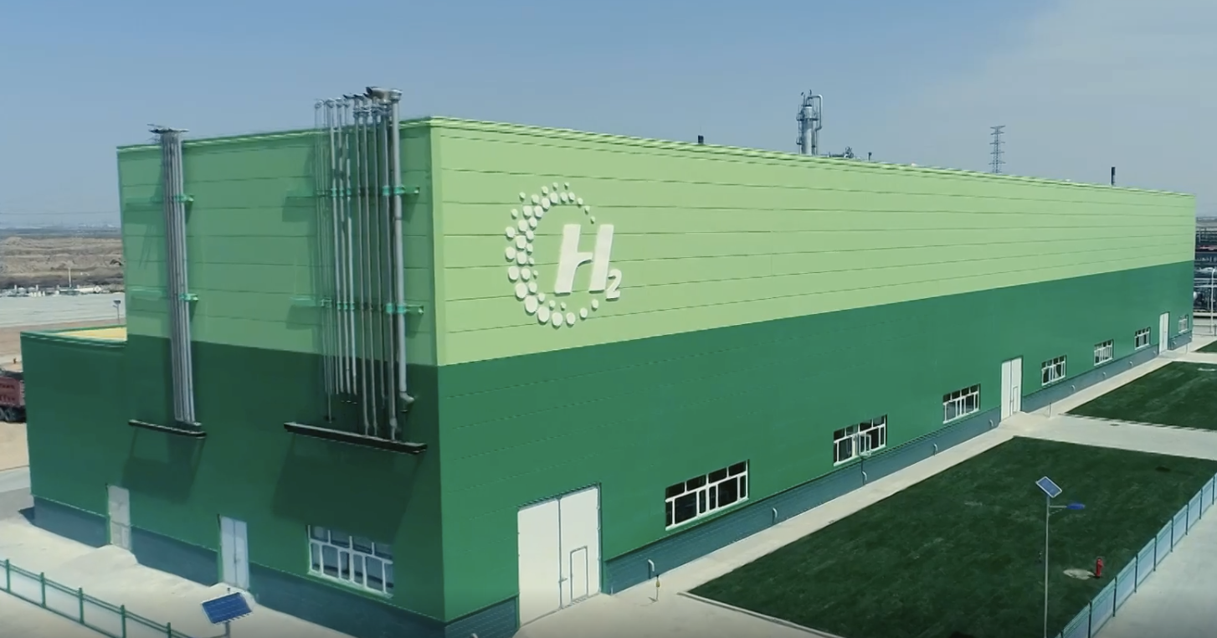

Electrolyzer Project Development and Asset Management
10 MW ITM PEM Electrolyzer REFYNE Project at Shell’s Rhineland Refinery
5 MW Plug PEM Electrolyzer Green Hydrogen Plant, Georgia
1
H
Hydrogen
720 kW Sunfire SOEC at Salzgitter Steel Production Facility in Germany
1.008
H₂ Architect Framework & Tool
Model-Based Systems Engineering
150 MW Ningxia Baofeng Energy Alkaline Electrolyzer Project in Ningxia, China
Use Moonshot techniques to achieve Earthshot goals!
Problem:
Electrolyzer project developers and asset managers are utilizing suboptimal, legacy oil and gas, project development and asset management methodologies. These techniques result in less than 22% of projects being on time, on budget, and within stakeholder’s specifications.^{[1]} This translates to direct increases of the LCOH due to rework late in the project’s design lifecycle.
Note:
This is not an issue for organizations in the aerospace and defense industry that utilize a model-based systems engineering (MBSE) approach for project and product development. Organizations/ projects that utilize MBSE, are 93% likely to be successful at meeting time, budget, and performance requirements.^{[2]}
Solution:
The H₂ Architect Project will develop a MBSE framework and tool tailored for electrolyzer project development and asset management; this will:
Maximize learnings from project to project through the digital twin template
Manage risk and complexity
Minimize cost over entire asset lifecycle
Improve overall project quality
Accelerate deployment of electrolyzer infrastructure
Increase the likelihood of overall success
Implementation of tailored MBSE solutions can result in ROIs of 40 – 144%!
[1] Application of MBSE to Oil and Gas Project/ Product Management Cycle – A model-based development approach for engineering management and design. (2020). Adeoti Asa, F. Massachusetts Institute of Technology.
[2] Systematic Literature Review: How is Model-Based Systems Engineering Justified?. (2016). Carrol, E and Malins, R. Sandia National Laboratory.

