Slide 1
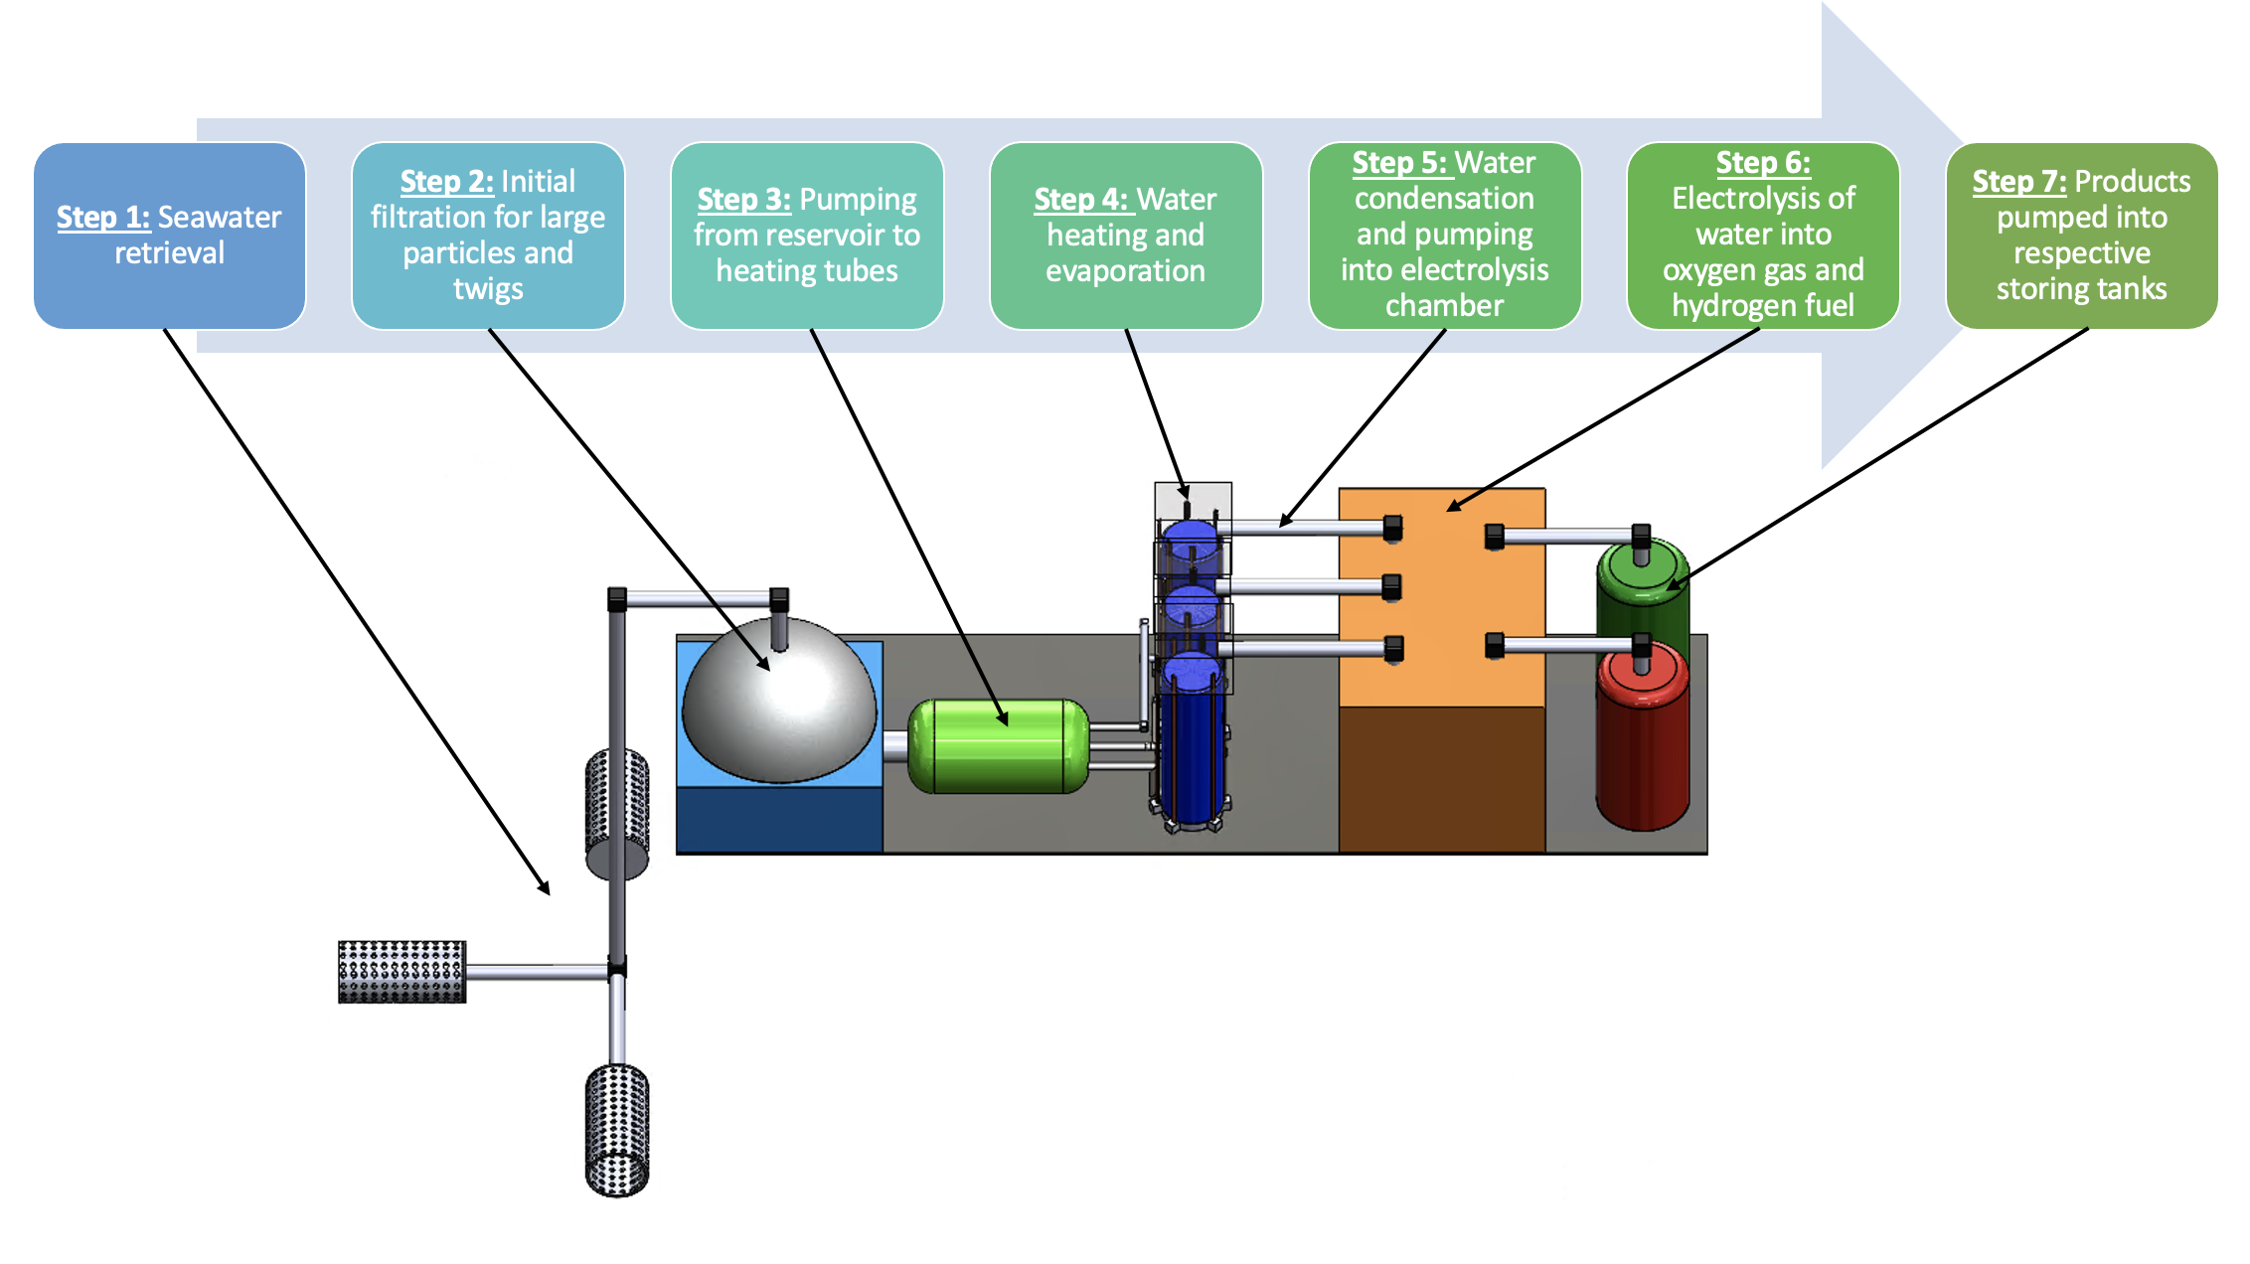
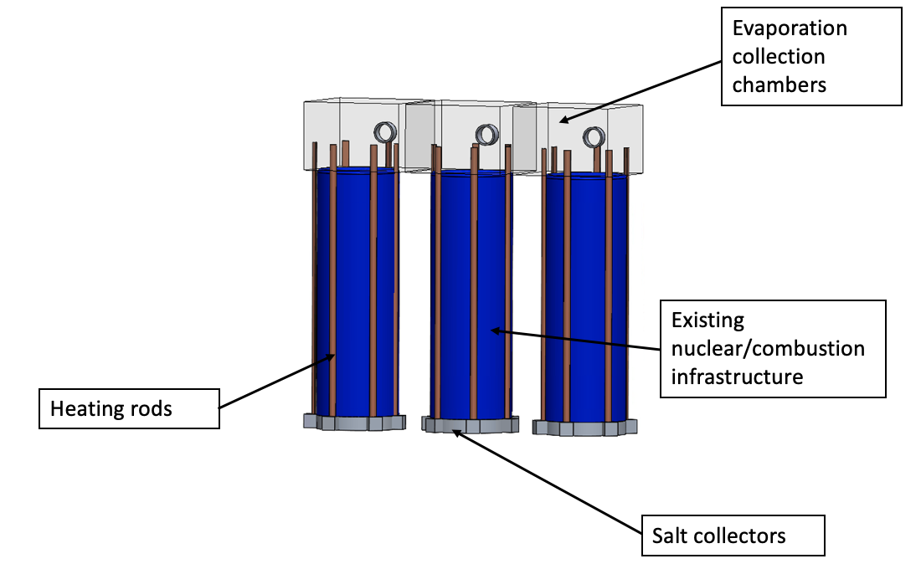
Seawater Hydrogen Fuel Production Through Power Plant Excess Heat Repurposing
Aditi Chintapalli, Jeannie Zhang, Riya Gyanmote
How will our innovation help achieve Hydrogen Shot Goal?
Our design uses seawater as an input to the electrolysis process instead of freshwater.
System utilizes heat which is released as a by-product of combustion/power production for desalination.
Intended to be an add on to existing power plants – which entails relatively low infrastructure costs.
Intended to be an add-on system to existing power plant and combustion system infrastructure to cost-effectively produce hydrogen fuel.
Multi-stage system design integrates salt-water retrieval, desalination, and electrolysis to split water into oxygen gas and hydrogen fuel.
Intended to be resized and modified to fit the requirements of the specific existing infrastructure.
Notes:
Replace with updated images

