Slide 1
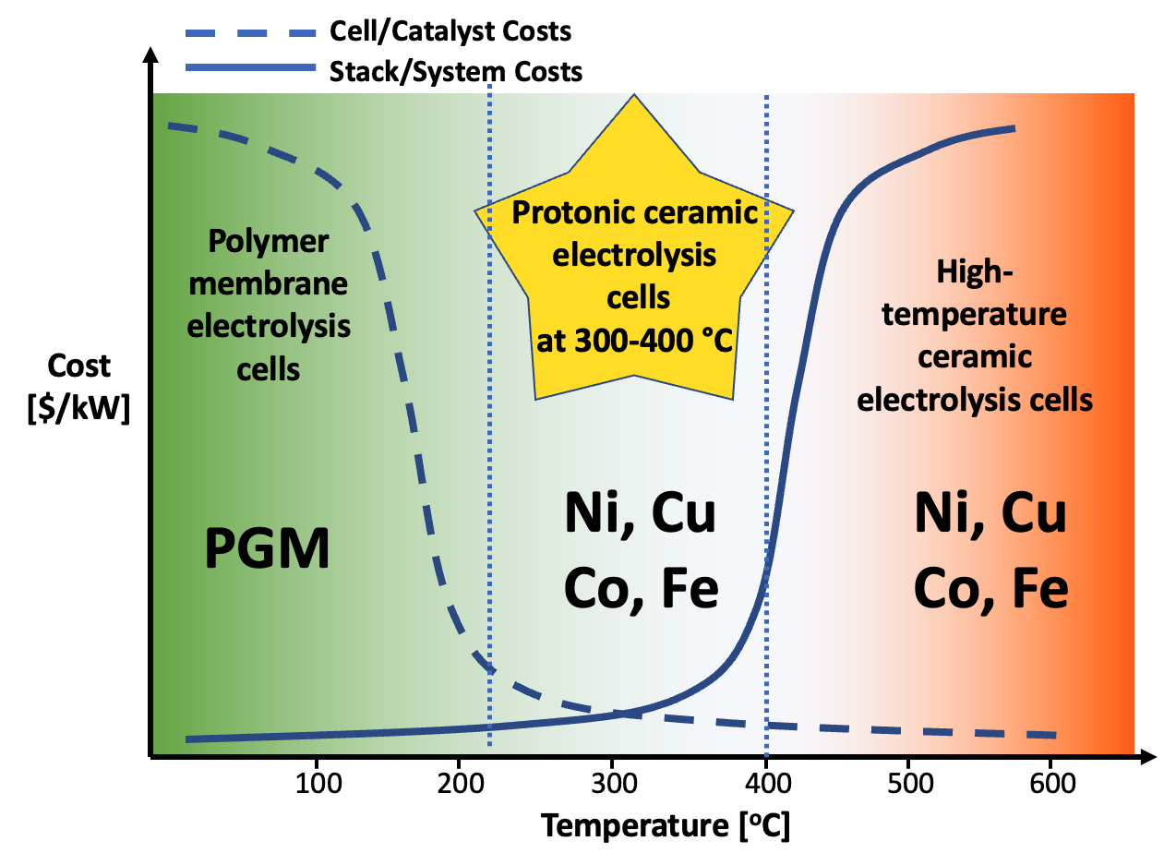
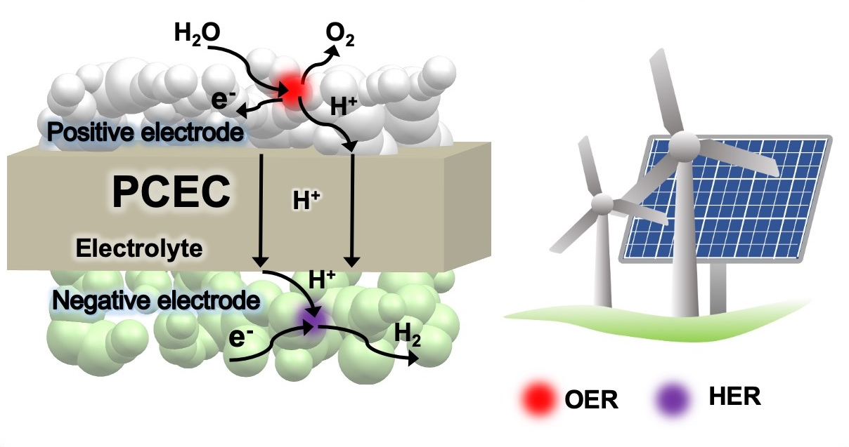
Hydrogen production via water electrolysis
at 300-400 °C

