Slide 1
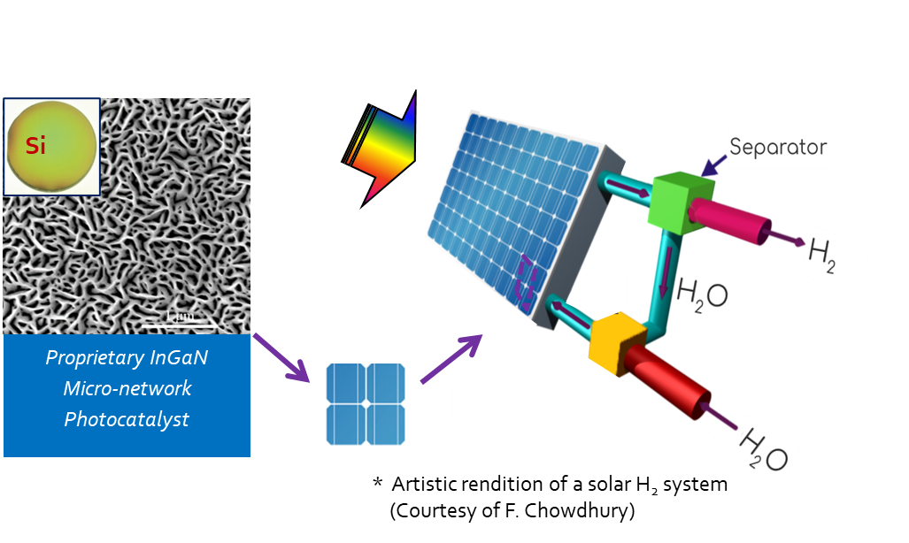
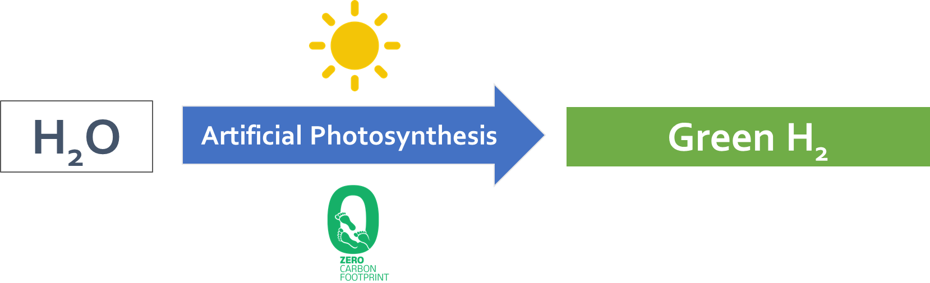
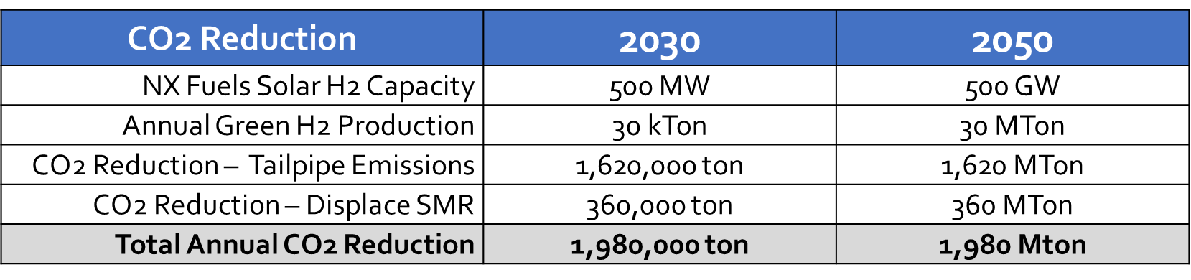
Low Cost Green H₂ from Water using Direct Solar
NX Fuels
Problem
Our Solution
Value Proposition
Achieve $1 per kg H₂ in one Decade
Impact on Emissions
      Incumbent and developing H₂ production methods cannot fully meet the rising demand of green H₂ for transportation and industrial energy applications cost effectively.
      NX Fuels’ solar H₂ system enables on-site production of clean H₂ that is up to 12 times lower in cost compared to those of competing approaches
      Our modular design allows facile scale up and quick implementation (like solar panels)
      Our technology can significantly improve the ESG performance for our customers
    Reduce tailpipe emissions by using H2 Fuel Cell heavy duty trucks
    Decarbonize H2 production
© 2022 NX Fuels, Inc. All rights reserved.

