Slide 1

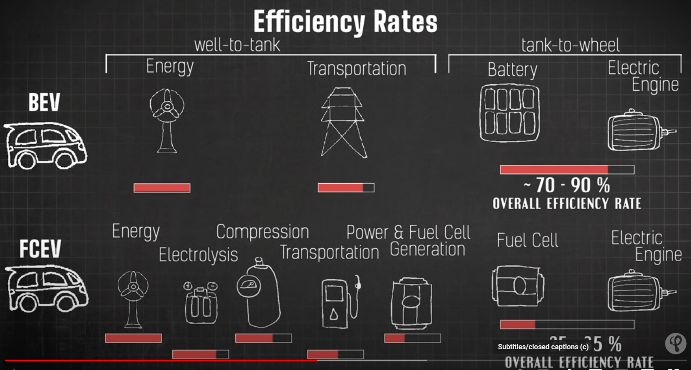
SolarHydro:
Green Hydrogen from Solar/wind at refueling station
Current efficiency rate comparisons assume a transportation cost for hydrogen refueling
For this reason, efficiency is reported as 25~35%
We propose to generate hydrogen using hydrolysis of water using solar/wind
Then compress the hydrogen also with the use of solar/wind at the refueling station
The transportation costs are then eliminated, and efficiency is increase to approx. 50% and is competitive with BEV
Location of refueling stations could be at existing gas stations or at a residential home or neighborhood.

