Slide 1




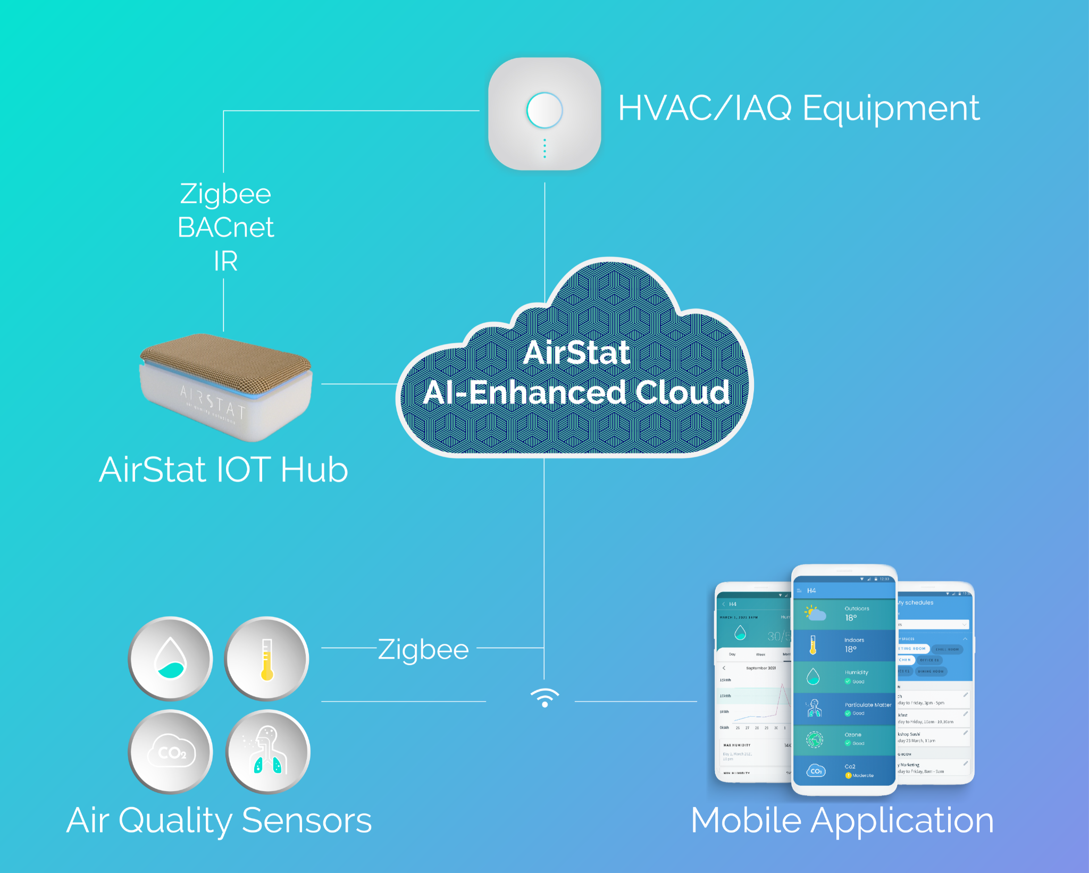





At AirStat we believe that Air Quality and Comfort should be for everyone.
AirStat is a Latinx/Hispanic owned company that has developed an AI platform to control HVAC and indoor air quality (IAQ) systems based on low-cost sensor networks and tenant’s comfort profile data feeding an advanced artificial intelligence (AI) cloud system that delivers customized, room-level “control recipes” to improve the health, productivity and wellbeing of building occupants, while reducing energy usage and associated greenhouse gas emissions.
Eduardo Sastre
Laidy R Saenz
Jose Guillermo Cedeño
Jordi Albo-Canals
Sebastian Solter
Breathe in. Breathe out. Save money.
Co-Founder & CEO
Co-Founder,
Head of People & Design
Co-Founder,
Head of R&D for Indoor Air Quality
Head of Technical Team
Co-Founder,
Head of Operations
  Confidential and Proprietary. AirStat, Inc.
  Confidential and Proprietary. AirStat, Inc.

Slide 2
ENERGY
HEALTH
ENERGY
HEALTH
DATA
DATA
  Confidential and Proprietary. AirStat, Inc.

Slide 3

ENERGY
HEALTH
DATA

