Slide 1

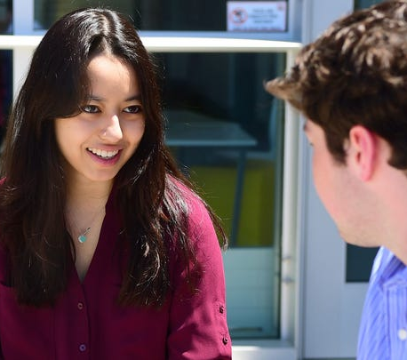
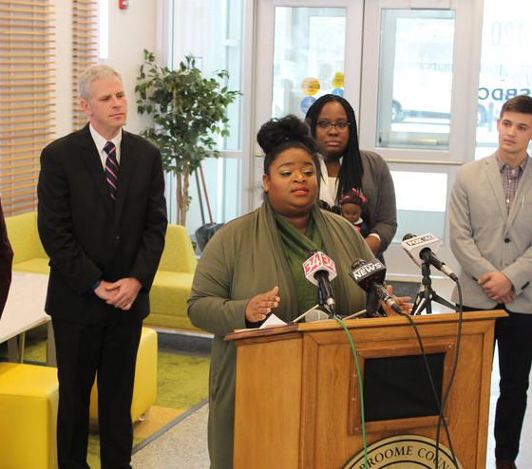
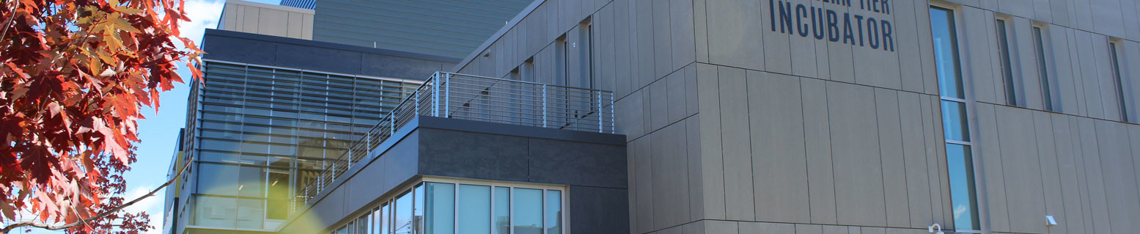
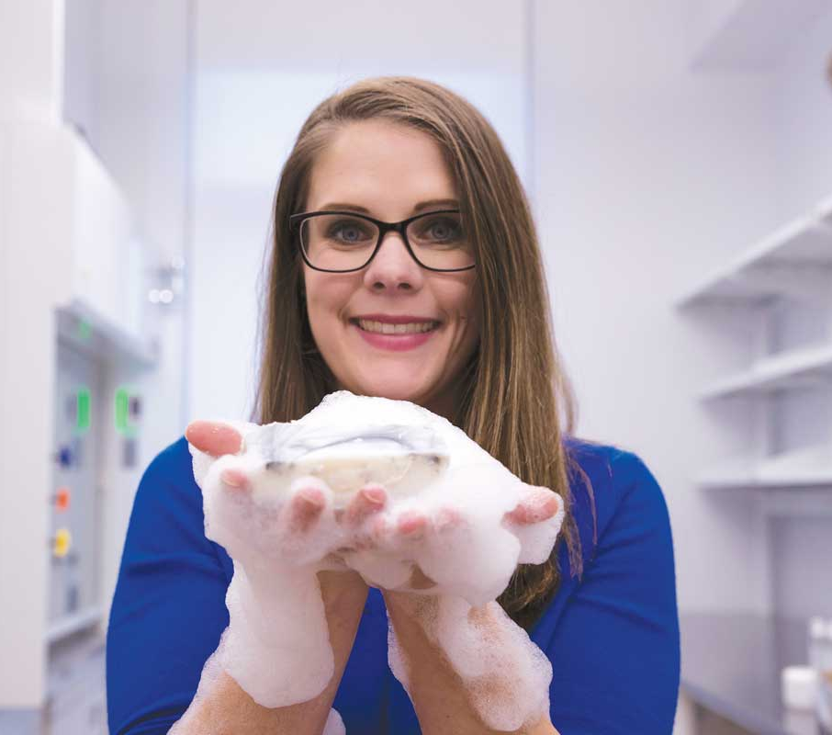
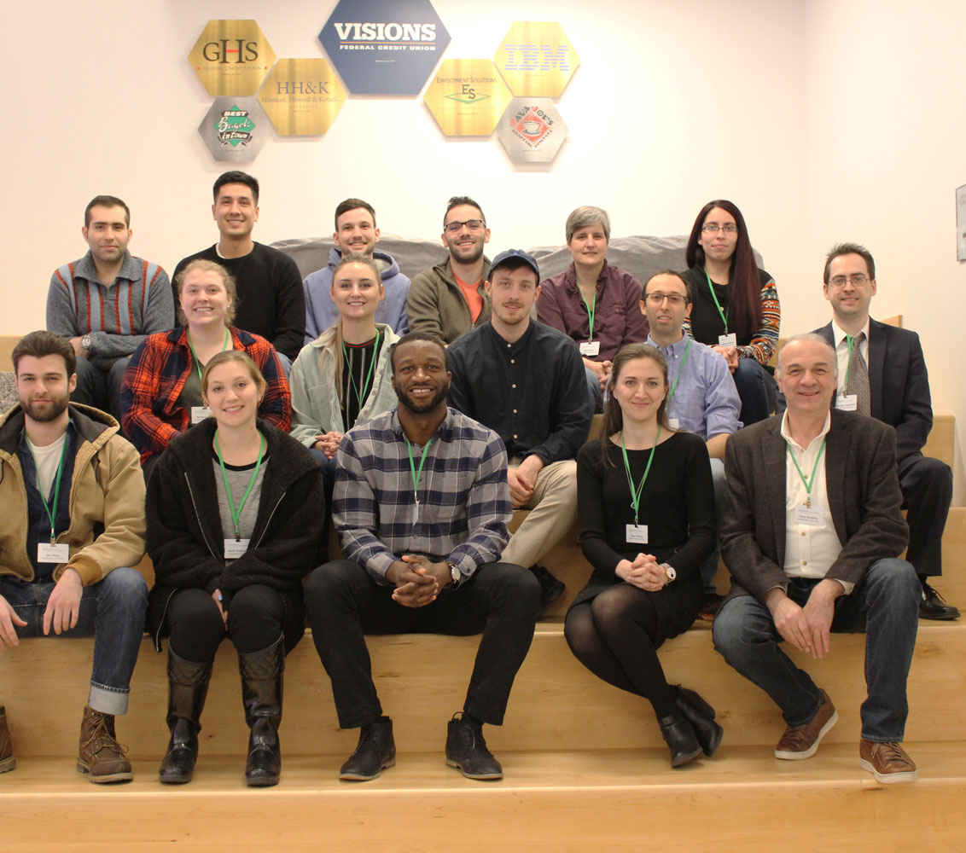
Diversify CleanTech
A comprehensive internship program for high school and undergraduate students with an environmental justice core curriculum hiring students from underserved communities increasing their job prospects and creating a more inclusive clean energy sector.
Environmental Justice Core Curriculum
CleanTech Internship Undergraduate Program
Binghamton High School Summer Program
Notes:
Srh comment – intro sentence…would just say ‘greater Binghamton community’ and not include reference to local academic institutions; ‘Regional Fund’ verbiage – do not need words ‘initially’ or ‘regional; ‘Incorporation Support’ verbiage – do not need ‘these’ and not sure about ‘women and minority’ (as is the thrust of STAND, as already established); see ‘Primer’ here has certain connotation (perhaps double entendre but will be lost on most reviewers); think we need to highlight 2 things with this ‘money slide’: that it is a competitive, non-equity (grant) program (potentially add something about what makes for a strong applicant/recipient) and that we (whoever that is exactly is a bit vague, but…) are going to co-invest with additional grant resources and in-kind support, or if you prefer can say that we will leverage our in-house resources as well as those from the NSF (and EDA-XCEED?) to boost the impact of the STAND initiative for the ventures.
Slides 4-7: Future Plans – Visionary
Creative and actionable ideas that build an inclusive R&D innovation ecosystem
If you are applying to the Visionary category
What is the vision or idea that could be developed with the help of prize funds if awarded?
Include specific elements of the plan relating to:
Feasibility
Risk
Measurable Goals (what does success look like?)
Who will benefit from your work, and why does that matter?

