Slide 1
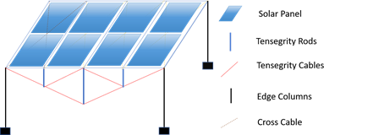
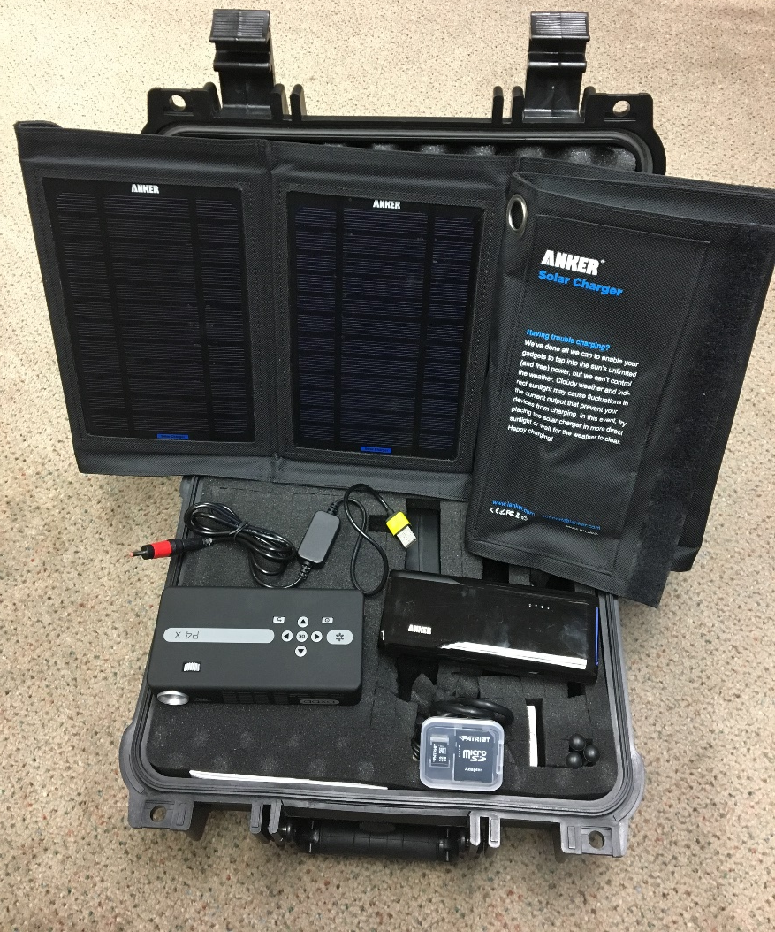
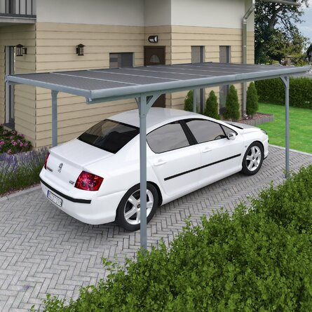
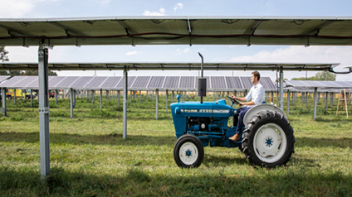
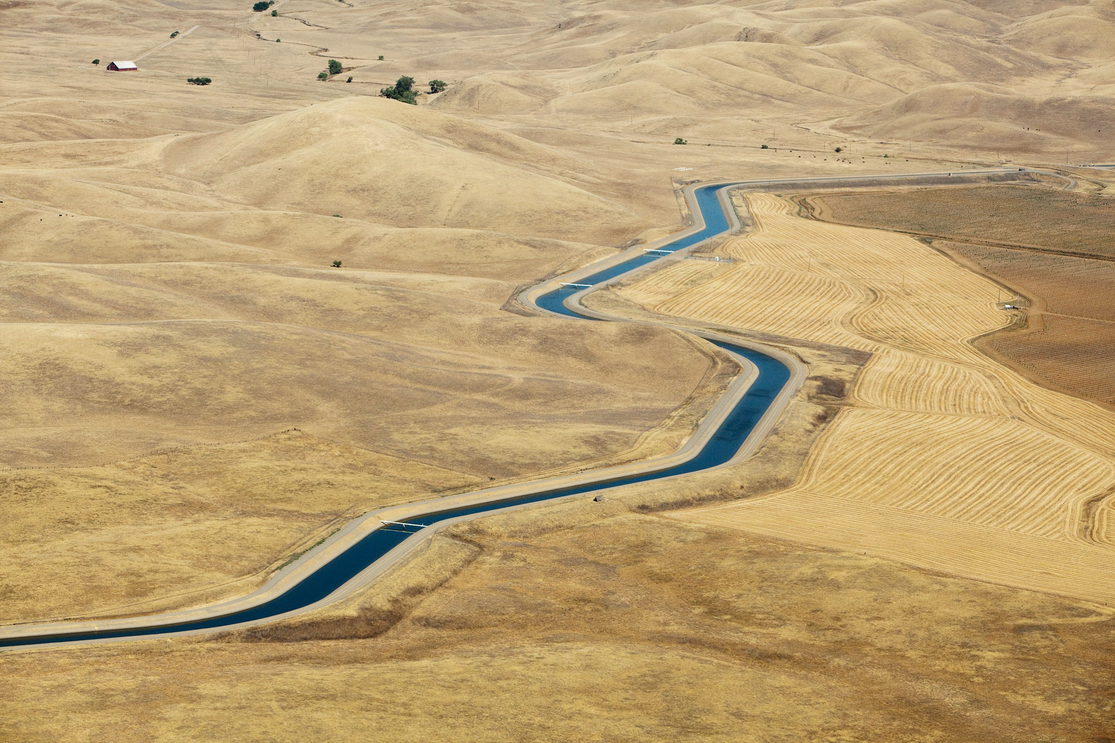
Distributed Renewable Entrepreneurship with Solar-in-Box Solutions
Deliverables:
Three different pilot projects
Operating model for community entrepreneurship involving all ecosystem stakeholders
Further improvement with technology, from pre-designed to pre-installed
Tensegrity for Solar PV
SPDCB
Technology
Applications
Agrivoltaics
Car port / canopy
Water Canal Covering

