Slide 1
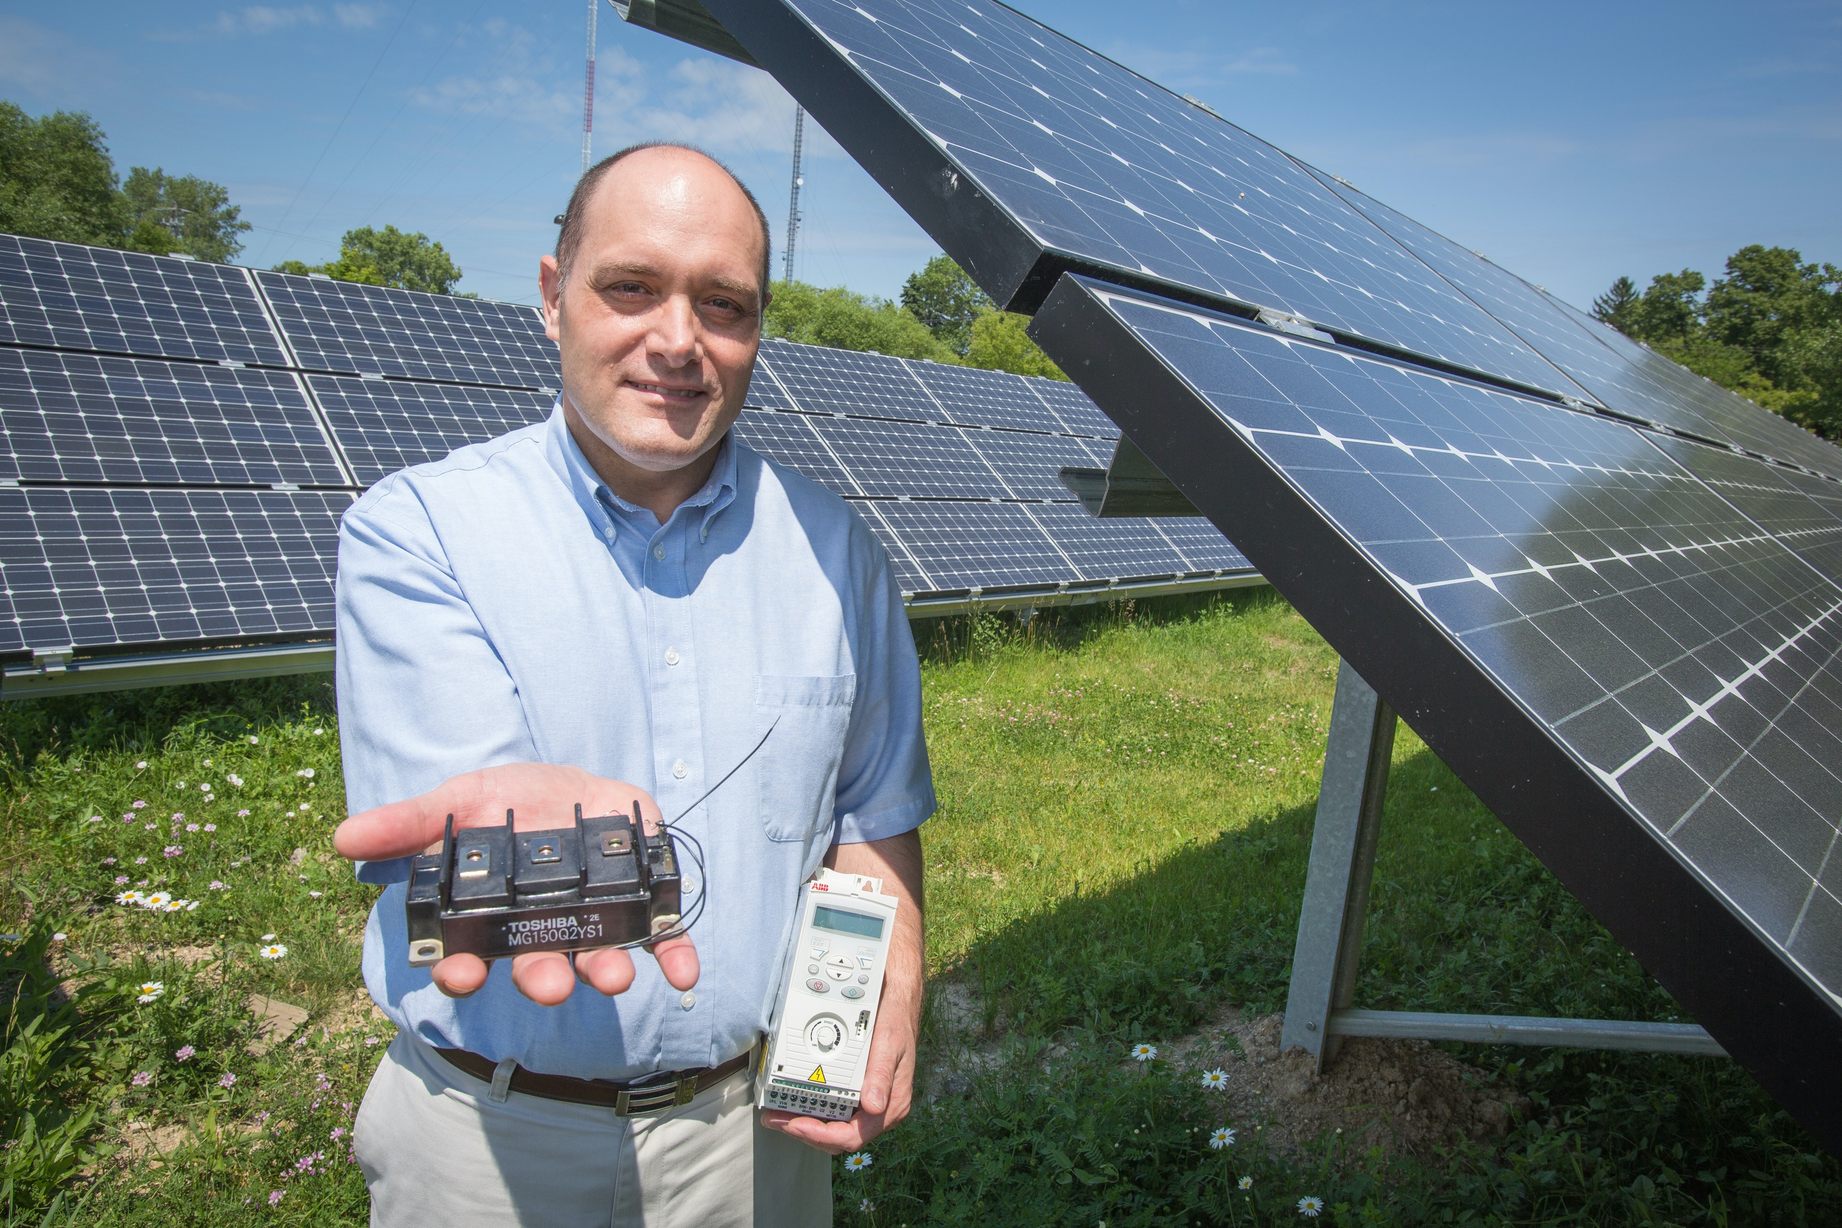
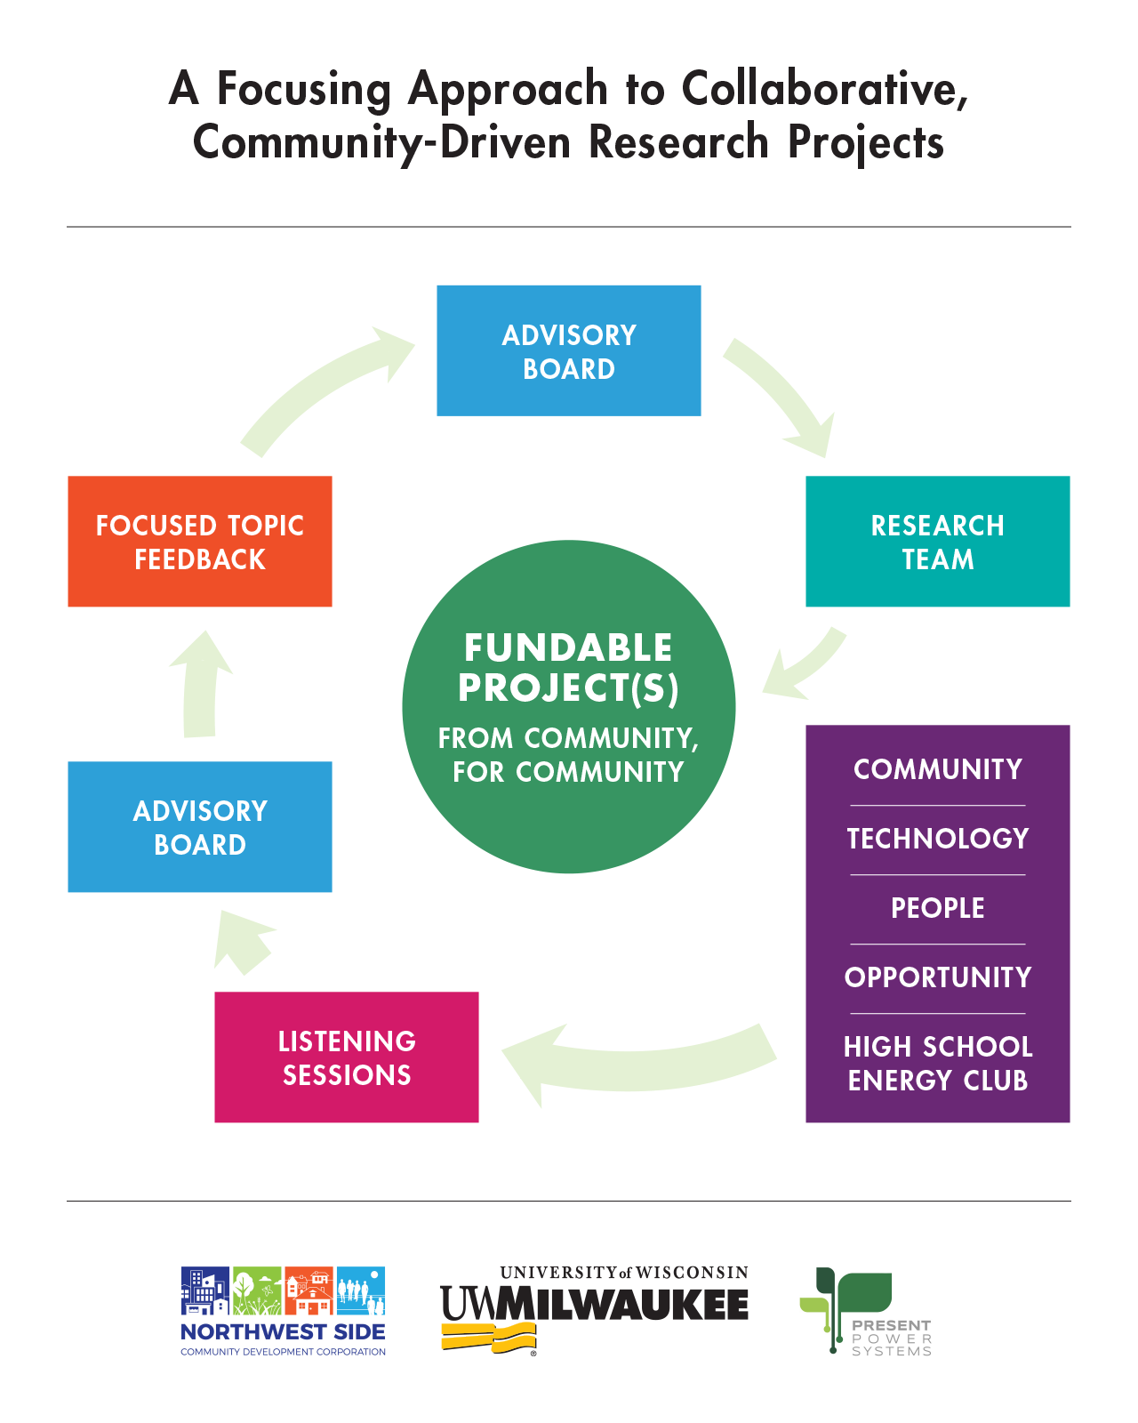
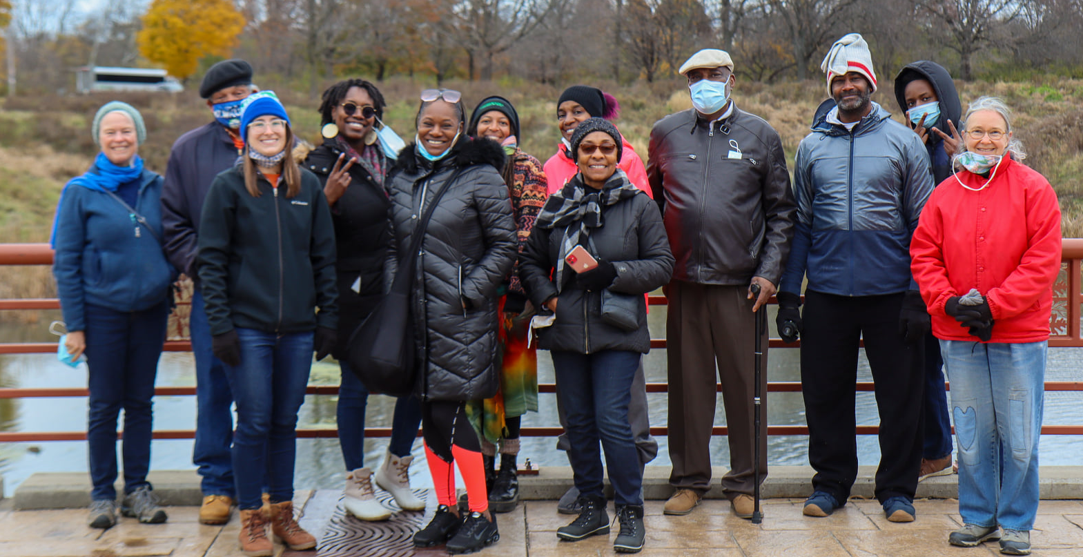
MKE Energy Partners
Flip the switch! Innovative energy solutions from communities, for communities.
Working together towards a clean and prosperous future.
Vision
Collaborate with disadvantaged communities to enact positive, sustainable economic and lifestyle advantages through community and business partnerships, using clean energy technologies as the catalyst.
Potential Clean Energy Solutions
Better ways to heat and cool homes safely and affordably.
Improving health and well-being by addressing the financial stress imposed by energy inequity.
Mobility and micro mobility solutions for an area that lacks public transportation.
Job creation and adult vocational training to alleviate high unemployment.
A variety of entrepreneurial opportunities taking root, as a new generation of startups revitalizes a city formerly known as The Machine Shop of the World.
3 Long-Term Partners
Northwest Side Community Development Corporation
Longstanding community connections
University of Wisconsin-Milwaukee
Clean energy + education expertise
Present Power Systems
Neighborhood-located entrepreneurial green tech start-up

